Slide 1

Princeton PFAS update – winter 2022
Private Well Monitoring and Phase II Project
Jeffrey Arps, LSP

Slide 2
PFAS Sampling & results
Project Overview
  PFAS detected in Town Hall Supply Well – September 2019
  Reported to MassDEP November 4, 2019, RTN 2-21072 assigned
  MassDEP drinking water standard based on sum of six PFAS compounds (PFAS6). These six compounds are:
  Perfluorodecanoic acid (PFDA)
  Perfluorononanoic acid (PFNA)
  Perfluorooctansulfonic acid (PFOS)
  Perfluorooctanoic acid (PFOA)
  Perfluoroheptanoic acid (PFHpA)
  Perfluorohexanesulfonic acid (PFHxS)
  Eight other analytes are reported but are not currently regulated. Six of these eight have not been detected in any Princeton well samples and all detected compounds are removed by the POET systems

Slide 3
Immediate response action (ira)
  Potable well impacts constitute IRA, “immediate” action needed
  Semi-annual sampling of private wells with PFAS6 detections
  Bottled water to properties where PFAS6 are <20 ppt
    Town meeting approved POETs for residences where PFAS6 <20
  POETs for properties where PFAS6 >20 ppt
  Semi-annual IRA Status Reports and semi-annual monitoring reports
    POET sampling:
      Sample effluent within first month
      After 1 year, sample mid-fluent and effluent semi-annually
      After 2 years, sample mid-fluent and effluent quarterly until GAC changed
        16 homes will move to quarterly sampling in April 2022
  IRA modifications are evaluated based on data

Slide 4
PFAS Sampling & results (WELLS)
Project Updates
  Results of October 2021 sampling identified condition changes
    Four homes moved from non-detect (ND) to <20 ppt
    Three homes moved from <20 ppt to >20 ppt
      68 Hubbardston detected PFAS6 at 5.9 ppt
    New radius to include three homes
    30 POET systems installed (PFAS6 >20 ppt), one pending
    47 properties provided with bottled water (PFAS6 concentrations <20 ppt) residences have the option to add a POET
    26 total homes around the edges of all radii are ND for PFAS
    No “breakthrough” has been detected at any POET (i.e., no detection of PFAS in water after treatment in primary GAC vessel)

Slide 5
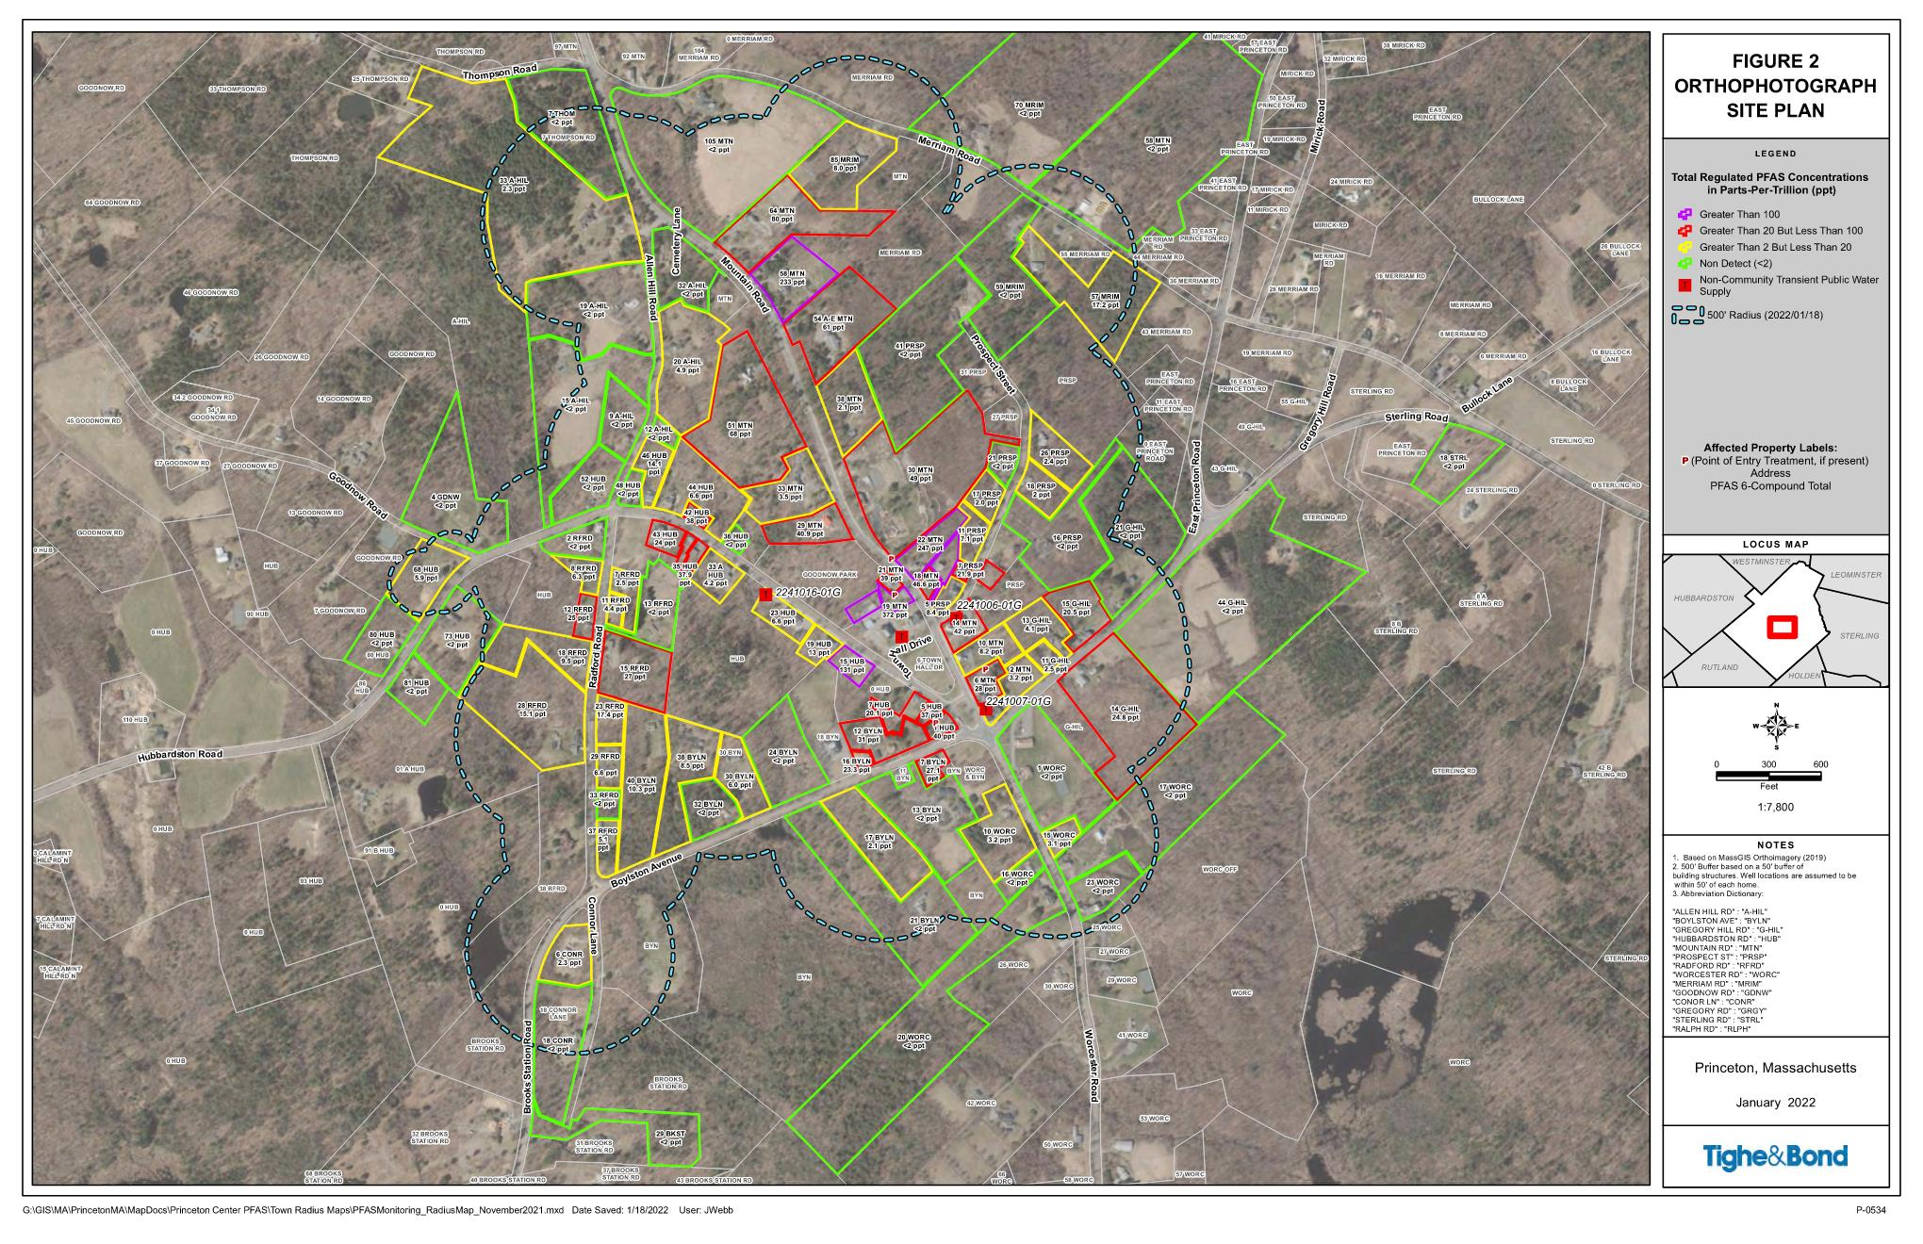
January 2022 Radius Map

Slide 6
Massachusetts Contingency Plan (MCP)
The MCP Process Consists of five “phases,” Phases I through V
  Phase I – (submitted November 9, 2020). Initial Site Assessment and Tier Classification (site is Tier I due to drinking water impacts)
  Phase II – due November 2023. Define vertical and horizontal extent of PFAS in all media (soil, groundwater, surface water, air), risk characterization.
  Phase III – due November 2024. Evaluation of remedial alternatives
  Phase IV - due with Phase III. Plan to implement remedy selected in Phase III
  Phase IV Completion/Phase V – due November 2025. Document remedy completion
  Sites can be closed at any time during this process with permanent or temporary solution
  IRA runs parallel to the “phase” process – no deadlines / IRA Status Reports

Slide 7
Phase ii comprehensive site assessment
  Current and on-going Phase II investigation efforts include:
  Quarterly groundwater monitoring at Town Hall campus
  Surface water sampling
  Soil sampling at several properties along lower Mountain Road where runoff from firefighting in 2017 was observed or reported
    Total PFAS
    Synthetic Precipitation Leaching Procedure (SPLP)

Slide 8
PFAS Sampling & results
  GROUNDWATER SAMPLING AT TOWN CAMPUS WELLS
  Eight monitoring wells sampled (five bedrock, three overburden)
  PFAS6 ranges from 45 to 1,309 ppt
  PFAS6 concentrations in shallow bedrock wells higher than PFAS6 in overburden wells

Slide 9
PFAS Sampling & results
  SURFACE WATER SAMPLING
  Sampled two ponds along Boylston Ave. and Gregory Hill Rd.
  Airport Pond and Schoolhouse Pond, sampled shallow and deep
    Airport Pond – PFAS6 at 2 ppt (shallow), 4 ppt (deep)
    Schoolhouse Pond - PFAS6 at 62 ppt (shallow), 65 ppt (deep)
    No detected concentrations exceed Surface Water Benchmark Values
  Also sampled Gregory Spring (on Princeton Conservation land)
    PFAS = not detected
  SURFACE RUNOFF SAMPLING
  Runoff near 30 Mountain Road continues to exhibit elevated PFAS concentrations (1,568 ppt, October 2021)
  Runoff near 41 Prospect was ND in April and July 2021

Slide 10
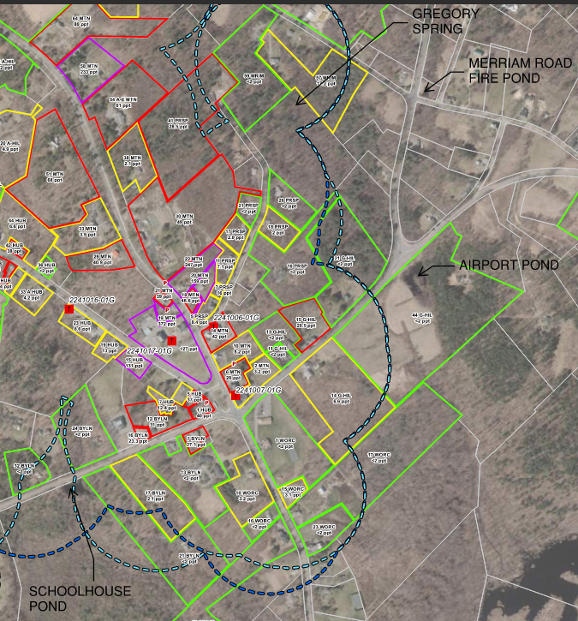
Pond/spring locations

Slide 11
PFAS Sampling & results
  SOIL
  Shallow soil (0”-6”) sampled at 22, 30 & 54 Mountain Rd in May 2021 – 24 samples
  Deeper soil to bedrock surface (6” to ~60”) sampled in October 2021 – 56 samples
  Majority of samples above DEP’s S-1/GW-1 soil standards
  Limited variation of concentrations with depth and soil type

Slide 12
PFAS Sampling & results
  SOIL (continued)
  Shallow soil sampled at 18, 19 & 21 Mountain Rd in November 2021) - 18 samples
  PFAS detections much lower than at 22, 30 & 54 Mountain Rd
  Limited number of detections above S-1/GW-1 soil standards
  Three additional shallow samples from Town property: two behind library, one below 30 Mountain Rd runoff location (October 2021)
    Library samples - one was below S-1/GW-1, the other included only one compound (PFHxS) above S-1/GW-1
    Soil below 30 Mountain Rd runoff location had 5 of PFAS6 compounds above S-1/GW-1

Slide 13
SPLP SOIl analysis
  Synthetic Precipitation Leaching Procedure
  SPLP is used to evaluate the potential for constituents present in a soil matrix to leach into groundwater
  Samples from 22, 30 and 54 Mountain Rd with a range of PFAS concentrations and different soil types selected for SPLP analysis
  Results indicate that the vast majority of PFAS remains in the soil
  In all of the SPLP analyses, the PFAS6 concentrations were above the GW-1 standard of 20 ppt
  Further evaluation of the SPLP results is necessary to determine if PFAS6 in soil is likely to substantially increase the extent, area or magnitude of environmental contamination

Slide 14
PFAS soil data interpretation
  Imminent Hazard Evaluation shows no IH for any soil locations
  All detected PFAS concentrations are below Method 2 “Direct Contact” soil standards: direct contact with soil does NOT pose a Significant Risk
  SPLP data will be used to model and evaluate impact of PFAS in soil to deep bedrock groundwater sources of drinking water
  Results of this analysis will be used to evaluate whether the soil concentrations are likely to substantially increase the extent, area, or magnitude of impacts to groundwater if mitigation is not implemented
  “Economic feasibility” is one factor considered in evaluating mitigation
  Soil disposal options are very limited and expensive – a recent U.S. Department of Defense policy suspends incineration of AFFF and PFAS-impacted media from DoD facilities, and this trend will expand

Slide 15
Project plan
  January 2022 – Monitoring well sampling, 4th round
  February 2022 – Bids for POETs for homes with <20 ppt
  March 2022 - Next IRA Status report due
  April 2022 – Semi-annual private well/POET sampling
  Finalize a plan for treatment of 30 Mountain Road runoff
  Continue to evaluate soil data to determine whether additional soil sampling is necessary and whether mitigation is necessary and feasible

