Slide 1
Cost Reduction Options Recap
Princeton Public Safety Building
11/15/2021

Slide 2
Cost Reduction Avenues
Four Categories
A
Program &
Feature
Reduction
B
Alternate
Construction
Methods
C
Asset
Reuse
D
Deferred
Or Alternate
Funding

Slide 3
Category A
Program & Feature Reduction
Remove one bunk room
Remove fitness room area
Potential to combine sergeants offices (not preferred)
Remove false dormers

Slide 4
Category B
Alternate Construction Methods
Reduced Cost Siding & finish options
Modular Construction
Prefab System (Post-Frame)
Insulated Concrete Forms (ICF)

Slide 5
Category C
Asset Reuse
Vehicle Exhaust Evacuation System
Generator (New, in crate at DPW)
General FF&E budget Reduction
Other Special Equipment from current facility

Slide 6
Category D
Deferred or Alternate Funding
FEMA: Assistance to Firefighters Grant Program
FEMA: Hazard Mitigation Grant
Mass Firefighter Safety Equipment Grant
EOC Funding Options

Slide 7
Prefab / Modular Options
Princeton Public Safety Building
11/15/2021

Slide 8
Modular
70% completed off-site in factory environment

Slide 9
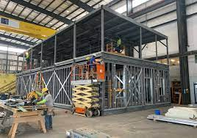
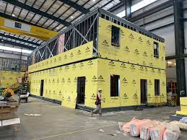
Local Precedent
Chelmsford, MA Fire Station
Triumph Modular (Littleton)
2 Story Steel Construction
$3.4 Mil. in borrowing
Approx 5,000 SF
No New Apparatus Bays
Price per SF $680

Slide 10
Pre-Fab Option
Post-Frame Construction

Slide 11
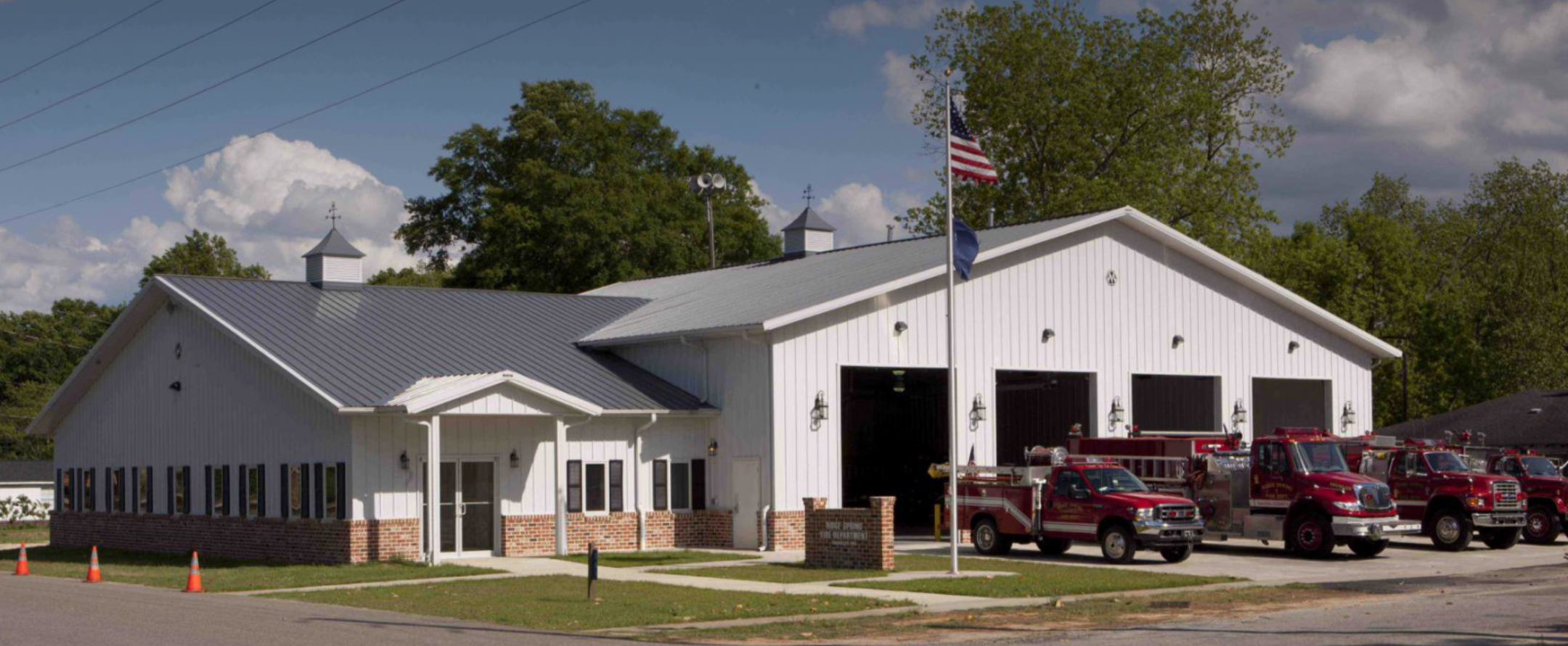
https://vimeo.com/129567016

Slide 14
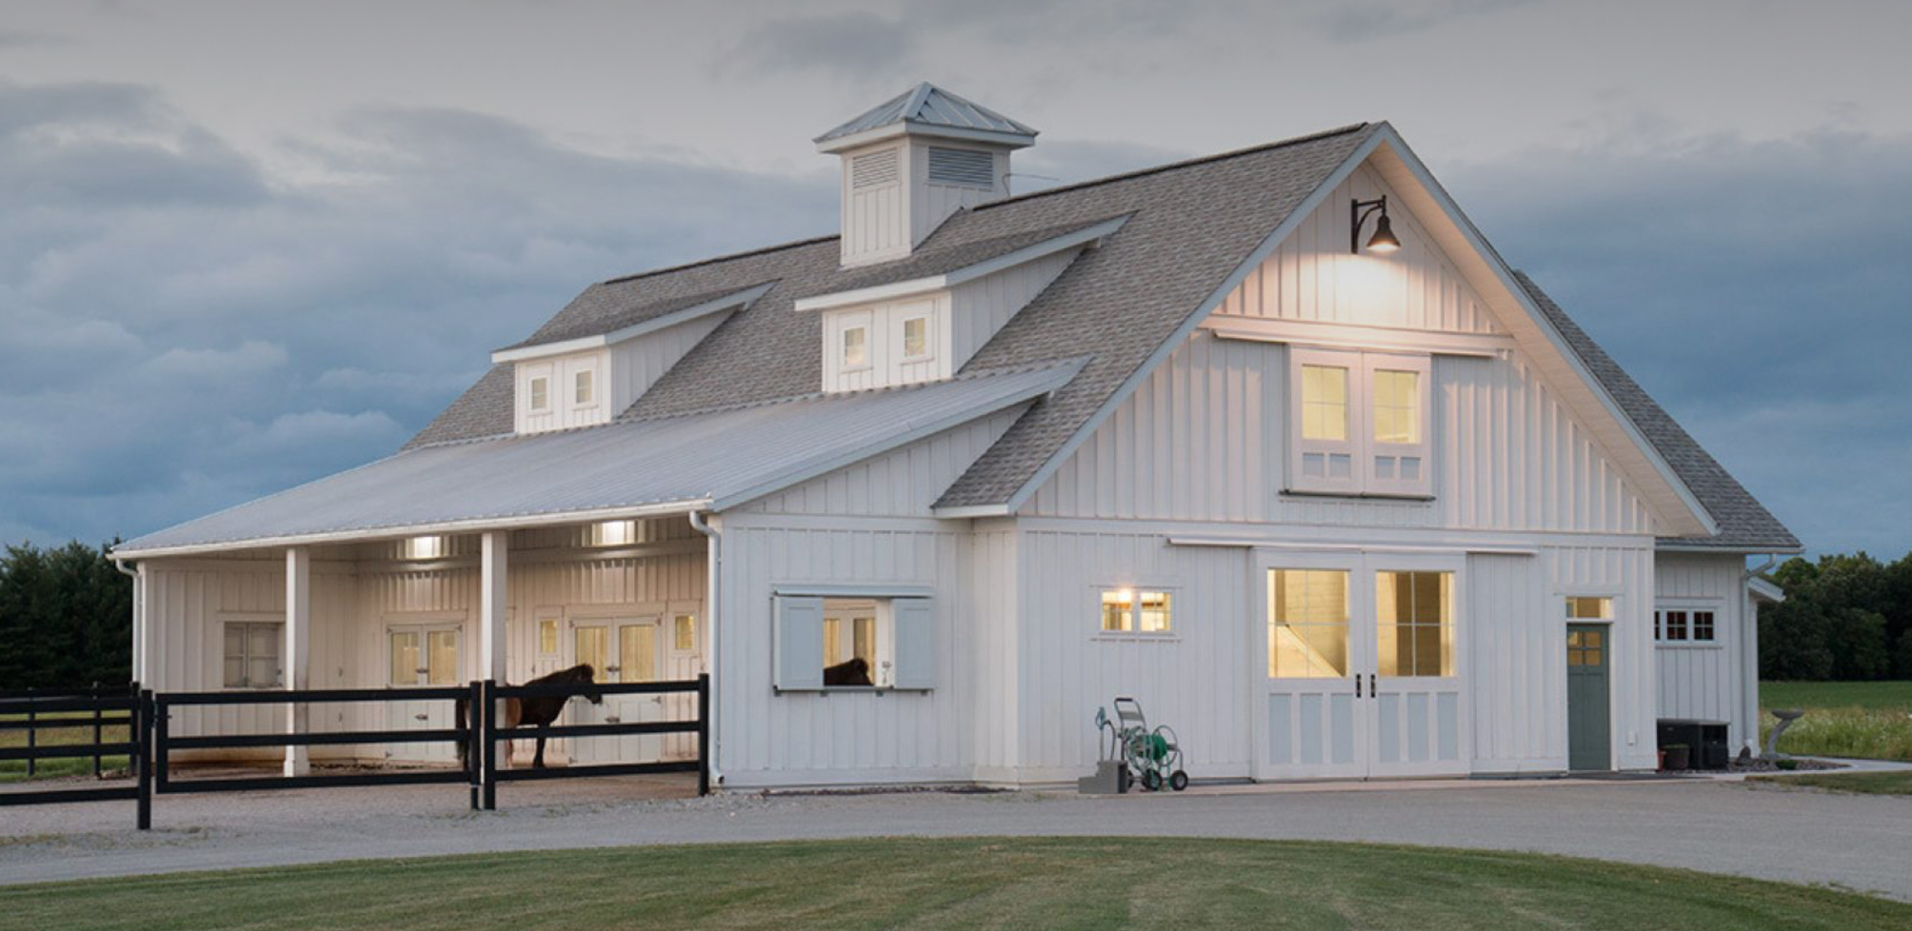

Slide 15
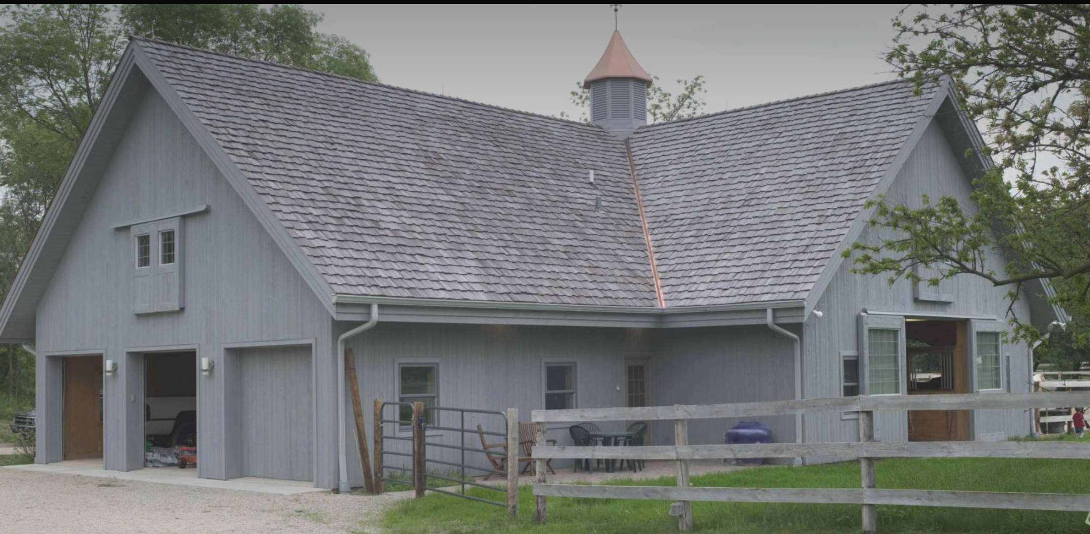

Slide 16
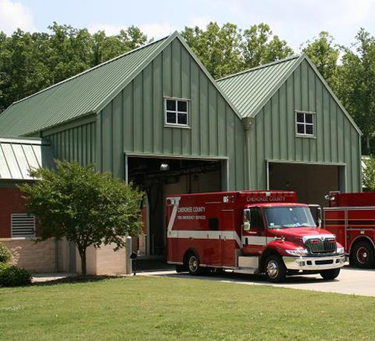
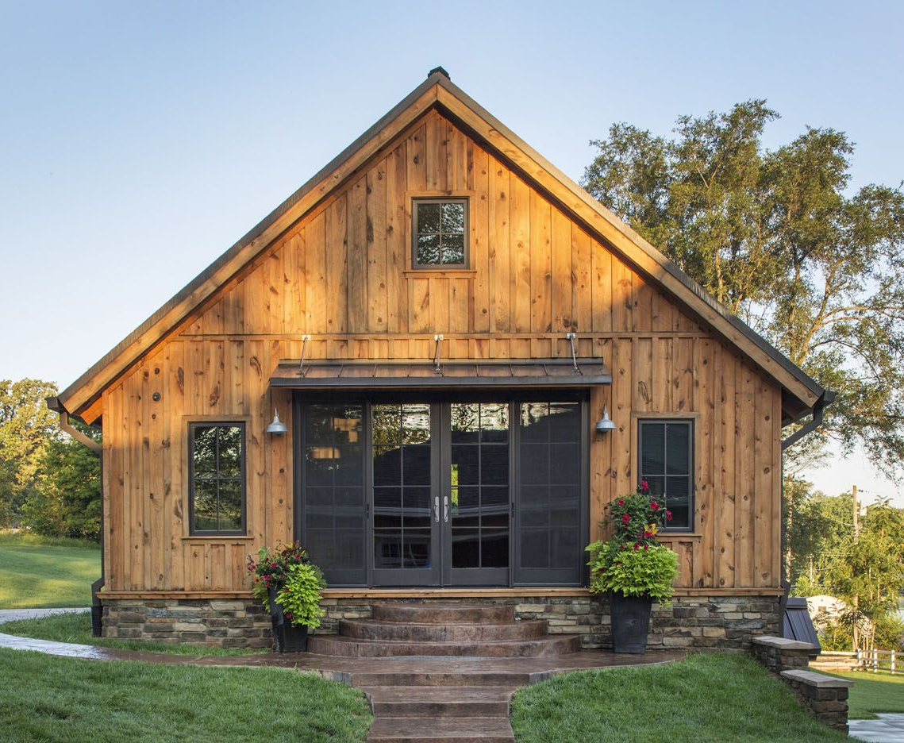
Simplicity of Form
Balanced Proportions
Shadow & Material
Subtle Historical Homage

