Slide 1
New Multifamily Zoning Requirement for MBTA Communities

Slide 2
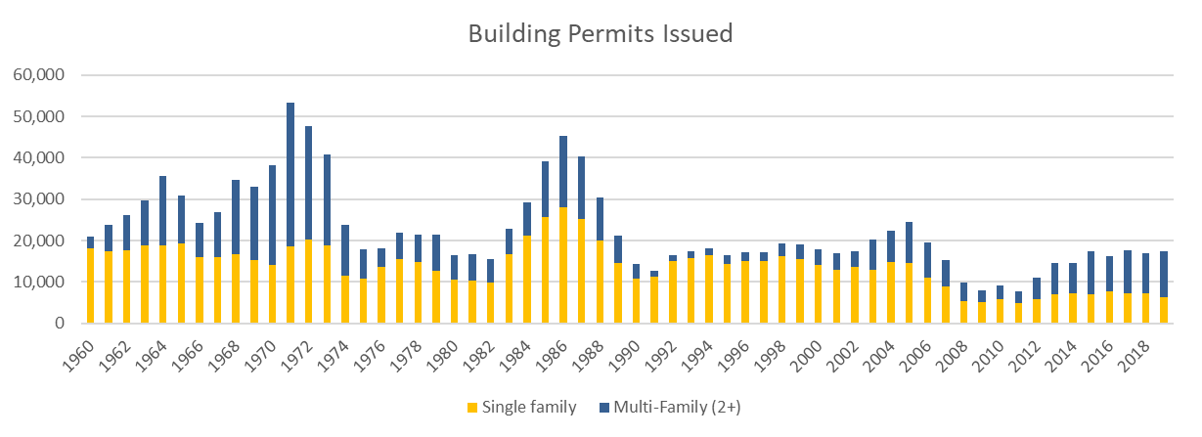
Housing Production in Massachusetts
Between 1960 and 1990, Massachusetts communities permitted almost 900,000 housing units. Since 1990, communities have permitted fewer than 470,000 new units.
As highlighted in the Future of Work study, there is an estimated shortage of up to 200,000 housing units.
Municipalities play a key role, through zoning and permitting, in determining whether or not housing is built. Cities and towns are therefore necessary partners if the Commonwealth is to solve our housing crisis.

Slide 3
The Housing Crisis
Before COVID-19, Massachusetts faced a core challenge in creating adequate housing to support young families, workers, and an aging population. The pandemic has further highlighted these needs.
Massachusetts has among the highest, and fastest growing, home prices and rents of any state in the nation.
Rising costs have dramatically increased financial pressures on low- and middle-income families, forcing them to sacrifice other priorities in order to pay housing costs. High housing costs are a primary driver of homelessness.
The lack of housing production is an impediment to community development.
These high costs are a disadvantage as we compete economically against peer states. The risk of future job growth moving outside Massachusetts is rising due to the high costs of living.

Slide 4
Confronting the Housing Crisis
2018 Housing Bond Bill:
In 2018, Governor Baker signed the largest housing bond bill in state history, authorizing more than $1.8 billion to the future of affordable housing production and preservation.
Since 2015, Massachusetts has invested more than $1.4 billion in the affordable housing ecosystem, resulting in the production and preservation of more than 22,000 housing units, including over 19,000 affordable units.
2021 Economic Development Bill:
Housing Choice Zoning Reforms: These targeted changes to M.G.L c. 40A reduce the threshold of votes needed to adopt certain zoning measures that promote housing production from 2/3 to simple majority.
Guided by a basic principle: Where there is majority consensus in communities around increasing housing production, a minority of voters should not be able to block zoning reform.
$50M for Transit Oriented Housing Development to produce new, high-density, mixed-income affordable housing developments located near major transit nodes and help mitigate environmental/traffic concerns
$50M for Neighborhood Stabilization to return blighted or vacant units back to productive use, including in communities disproportionately affected by COVID-19
$10M for Climate-Resilient Affordable Housing Production of affordable, multi-family housing developments, with the goals of equipping homes to better respond to climate changes and reducing greenhouse gas emissions
ARPA Spending Package:
Homeownership: $115M for the CommonWealth Builder Program and $65M for First-Time Homebuyer Assistance
Affordable Housing: $115M for the Affordable Rental Units and $150M for Supportive Housing
Eviction Diversion Initiative:
The Baker-Polito Administration has transformed a $20M homelessness prevention program to an over $700M comprehensive, state and federally funded disaster relief initiative. From March 2020 through December 2021, DHCD distributed $460.8M in assistance to 61,142 unique households.

Slide 5
Transit-Oriented Housing Development
Importance: We must continue to leverage housing best practices to meet the state’s housing needs and position Massachusetts well for the future.
Opportunity: In late 2019, the Mass Housing Partnership (MHP) evaluated 261 station areas in Greater Boston and found the median housing density across all station areas is roughly 6.2 homes per acre. MHP concluded that a modest increase to just 10 homes per acre could yield approximately 253,000 additional housing units over time.
Benefits: By allowing multifamily housing near transit, we can create new housing in walkable neighborhoods closer to transit. This is not just good housing policy, it is good climate and transportation policy, too. The result of transit-oriented development is:
More housing closer to the places that we go every day, such as local shops, jobs, schools, restaurants, parks, etc.
Better access to work, services, and other destinations by increasing mobility and utilization of public transit
Reduced reliance on single occupancy vehicles, which helps in our larger effort to confront the climate crisis

Slide 6
What We Are Discussing Today
When the Governor signed the multi-family zoning requirement for MBTA communities into law last January, he made clear that the Administration will take a thoughtful approach in developing compliance criteria in accordance with the new law.
To that end, the draft guidelines:
Are consistent with the underlying law
Focus on zoning—the local rules that govern where housing can be built
Recognize that a multi-family district that is reasonable in one city or town may not be reasonable in another city or town
Provide local control—municipalities have discretion where multi-family districts are located and the rules established in those districts
This is a real opportunity to establish a new paradigm for encouraging multi-family housing production.

Slide 7
What We Are NOT Discussing Today
The draft guidelines do not:
Include a production mandate or a requirement to build new units
There is no requirement to construct a particular number of units, or any units at all. This new law requires multi-family by right zoning, not housing production.
Have anything to do with “Chapter 40B” which allows developers to bypass local zoning in communities where there is not enough affordable housing
This is not that! Unlike 40B, these draft guidelines have nothing to do with the permitting of individual projects.
Actual production will depend on several factors, including developer interest, infrastructure, market dynamics, etc. It will also take time—this is about creating capacity for the future.

Slide 8
Relevant Section from the Economic Development Bill:
Chapter 358 of the Acts of 2020
SECTION 18. Said chapter 40A is hereby further amended by inserting after section 3 the following section:-
Section 3A. (a)(1) An MBTA community shall have a zoning ordinance or by-law that provides for at least 1 district of reasonable size in which multi-family housing is permitted as of right; provided, however, that such multi-family housing shall be without age restrictions and shall be suitable for families with children. For the purposes of this section, a district of reasonable size shall: (i) have a minimum gross density of 15 units per acre, subject to any further limitations imposed by section 40 of chapter 131 and title 5 of the state environmental code established pursuant to section 13 of chapter 21A; and (ii) be located not more than 0.5 miles from a commuter rail station, subway station, ferry terminal or bus station, if applicable.
(b) An MBTA community that fails to comply with this section shall not be eligible for funds from: (i) the Housing Choice Initiative as described by the governor in a message to the general court dated December 11, 2017; (ii) the Local Capital Projects Fund established in section 2EEEE of chapter 29; or (iii) the MassWorks infrastructure program established in section 63 of chapter 23A.
(c) The department, in consultation with the Massachusetts Bay Transportation Authority and the Massachusetts Department of Transportation, shall promulgate guidelines to determine if an MBTA community is in compliance with this section.

Slide 9
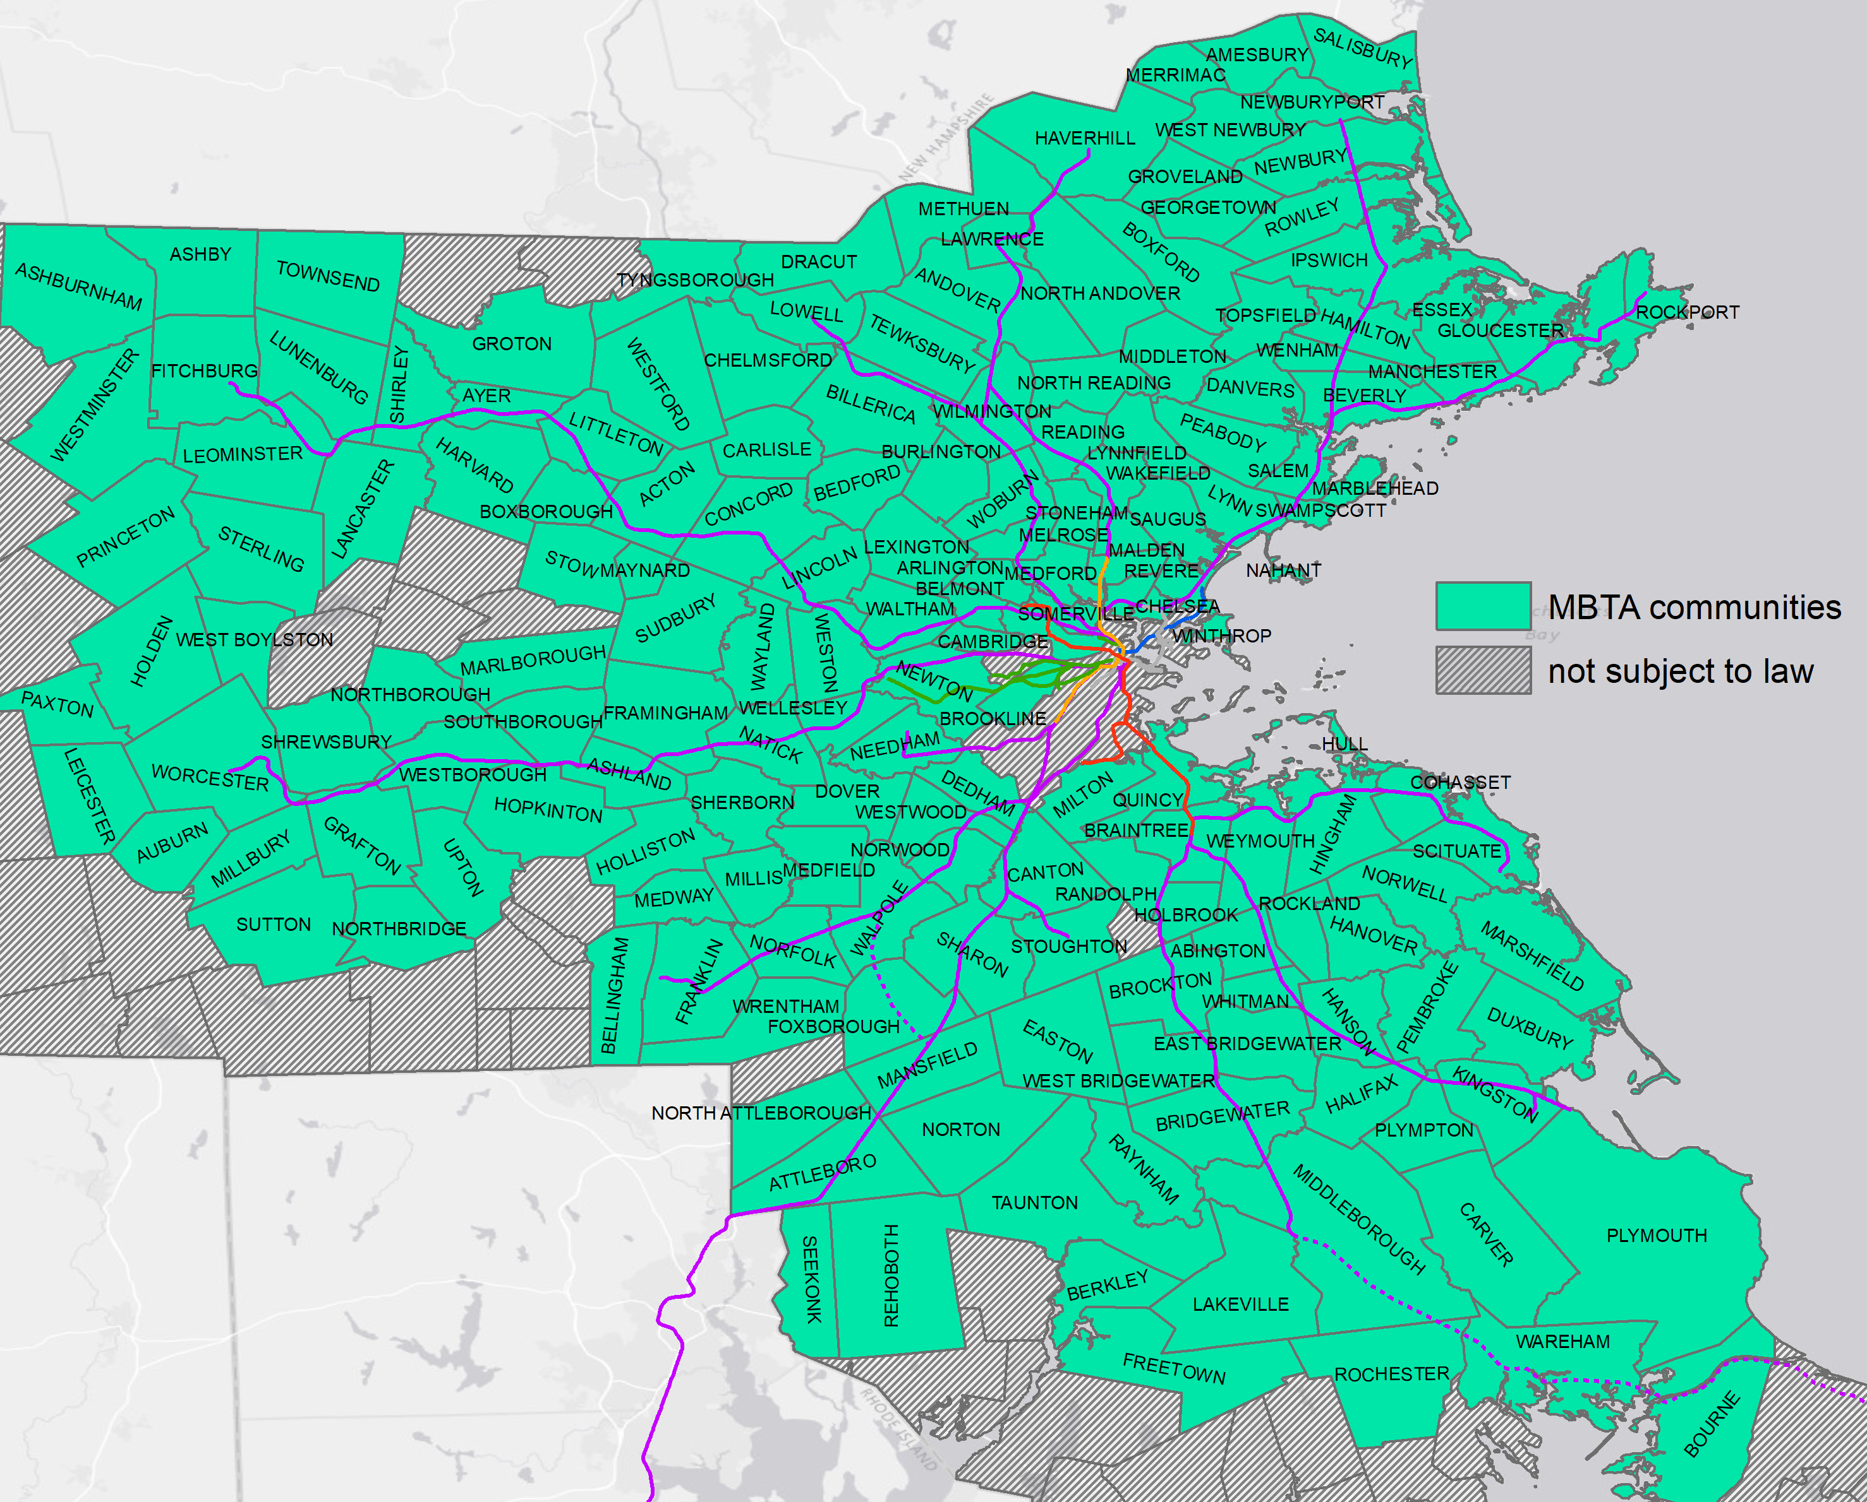
What is an MBTA Community?
“MBTA community” is defined by reference to G.L. c. 161A, sec. 1.
There are 175 municipalities* subject to this new law:
*Note, Boston is not subject to the Zoning Act (c. 40A) including section 3A.

Slide 10
Reasonable Size: Land Area & Unit Capacity
DHCD issued preliminary guidance on January 29, 2021. The preliminary guidance provided that MBTA Communities will be deemed to be in compliance with this new section until more detailed compliance criteria are established. These draft guidelines propose those compliance criteria.
The draft guidelines outline a two-part test to determine reasonable size:
Minimum Land Area: multi-family districts must comprise at least 50 acres of land—or approximately 1/10 of the land area within 0.5 mile of a transit station -- with a minimum gross density of 15 units per acre, subject to any further limitations imposed by relevant aspects of the state environmental code.
Minimum Multi-Family Unit Capacity: The multi-family unit capacity is a number of units based on a percentage of total housing units within the community. This represents the number of multi-family housing units that can be developed as of right within the multi-family district. That percentage varies by access to transit:
Service Type/Category | Minimum MF % of Total Housing Stock | # of communities
Subway or light rail communities | 25% | 17
MBTA bus communities | 20% | 35
Commuter rail communities | 15% | 48
“Adjacent” communities, no MBTA transit service | 10% | 75
Notes:
The law provides that each MBTA Community must have a multi-family district of “reasonable size” in which multi-family housing is permitted as of right.

Slide 11
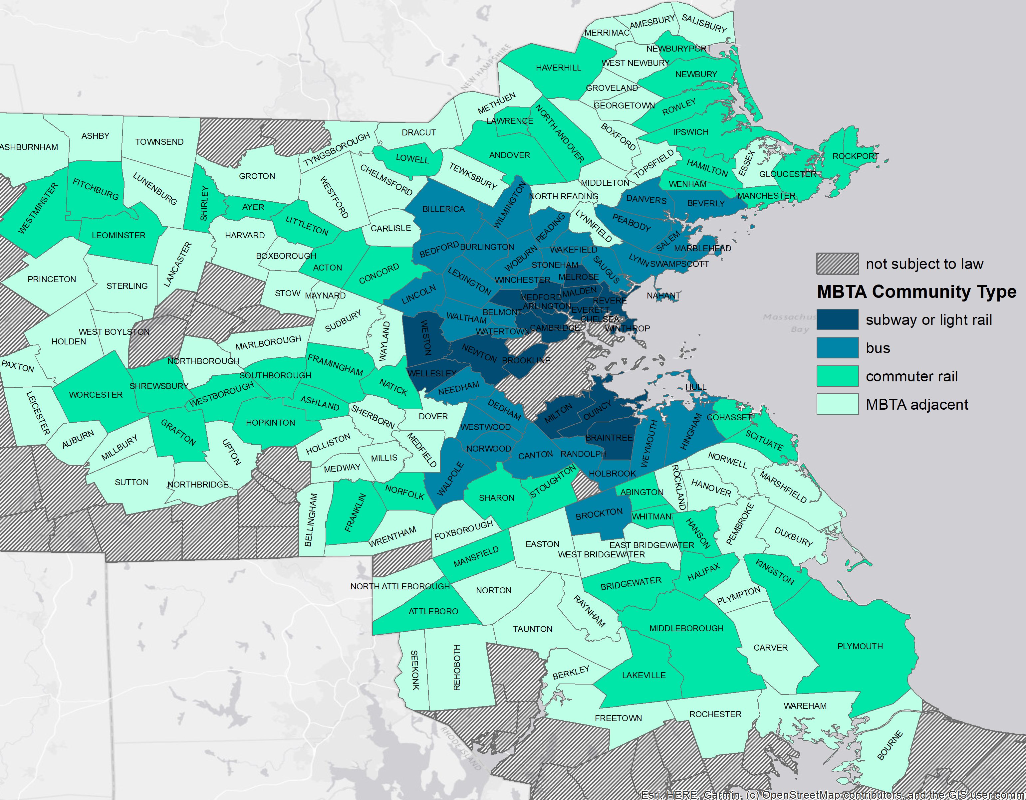
MBTA Communities By Category of Service
All communities served by the MBTA need to zone to allow for multifamily housing by-right, with a greater obligation for communities with higher levels of transit service.

Slide 12
Closer Look at Minimum Unit Capacity
In addition to the minimum land area test, the minimum unit capacity test means that each district must have capacity for a minimum number of multi-family units (existing or potential).
For example, for a municipality with 10,000 housing units, the minimum capacity will vary based on the type of service:
Important to remember that this is about capacity—enabling production by expanding capacity through zoning. Actual unit production will depend on many factors.
Service Type/Category | Minimum MF % of Total Housing Stock | Minimum capacity for multi-family housing
Subway or light rail communities | 25% | 2,500
MBTA bus communities | 20% | 2,000
Commuter rail communities (a rail station in the community or within 0.5 mile) | 15% | 1,500
“Adjacent” communities, no MBTA transit service | 10% | 1,000

Slide 13
Size and Density Requirements
Section 3A requires districts be of “reasonable size” and have a minimum gross density of 15 units per acre:
Unit capacity is the minimum number of multi-family units the zoning allows as of right. Each community’s minimum unit capacity is a percentage of its existing housing stock.
The gross density requirement is a simple formula: 15 units times the number of acres in the district. A district comprising 50 acres (i.e. the minimum land area) must allow as of right at least 750 units (15 x 50) to meet the gross density requirement.
Each multi-family zoning district must satisfy both tests. In some cases, the minimum number of units will be equal to the minimum unit capacity. In other cases, the minimum number of units allowed as of right will be determined by the gross density requirement.
This explains why 750 units is a floor for all communities under the draft guidelines.

Slide 14
Location of Districts
The statute provides that “a district of reasonable size shall…be located not more than 0.5 miles from a commuter rail station, subway station, ferry terminal or bus station, if applicable.”
MBTA communities with some land area within 0.5 miles of a transit station:
Require at least ½ of land area of the multi-family zoning district to be located within the prescribed distance, with exceptions only in unusual cases.
MBTA communities with no land area within 0.5 miles of a transit station:
The multi-family district should be located in an area with reasonable access to a transit station based on existing street patterns, pedestrian connections, and bicycle lanes, or in an area that otherwise is consistent with the Commonwealth’s sustainable development principles (e.g., near an existing downtown, village center, or an area of concentrated development).
Notes:
The 0.5 mile radius should be measured from the boundaries of all parcels in the transit station, rather than a from a “pin” dropped in the center.

Slide 15
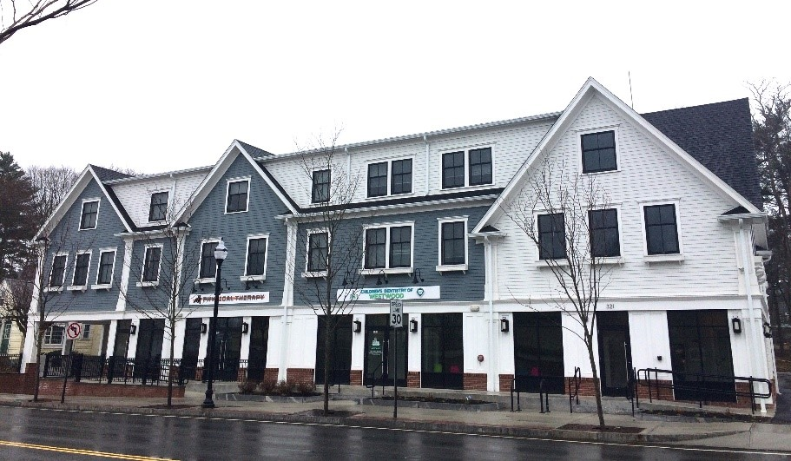
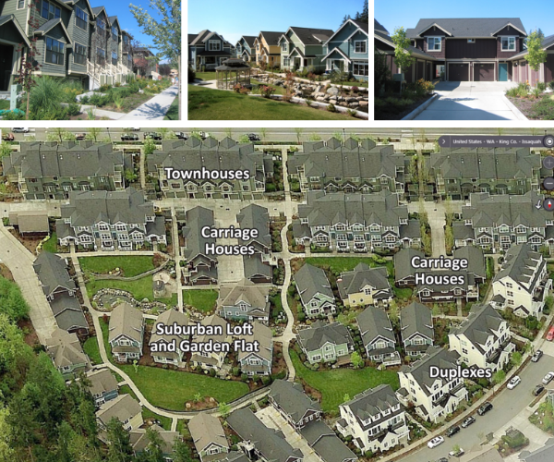
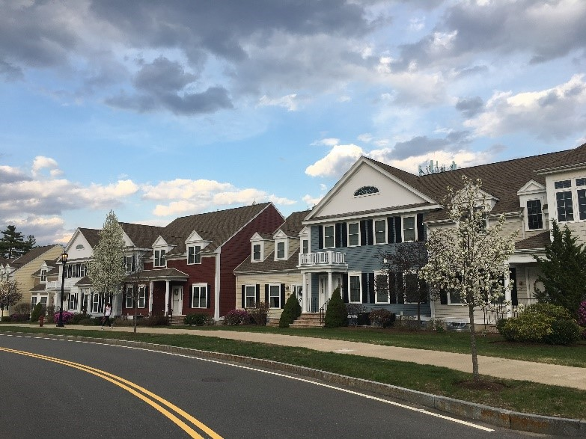
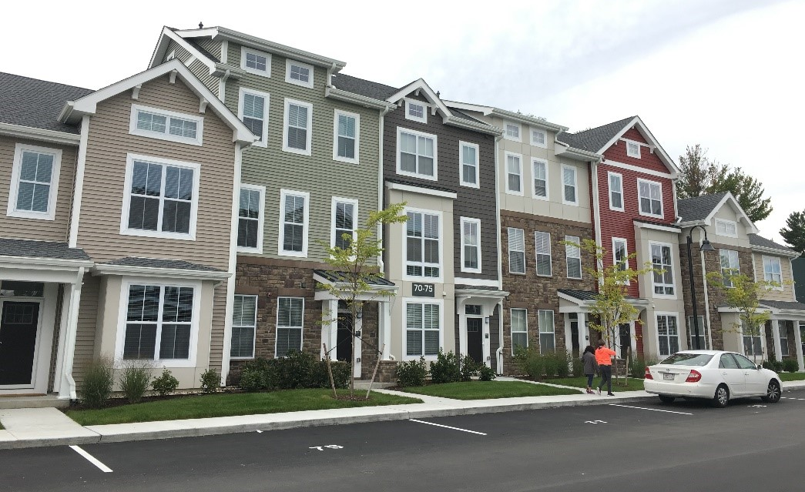
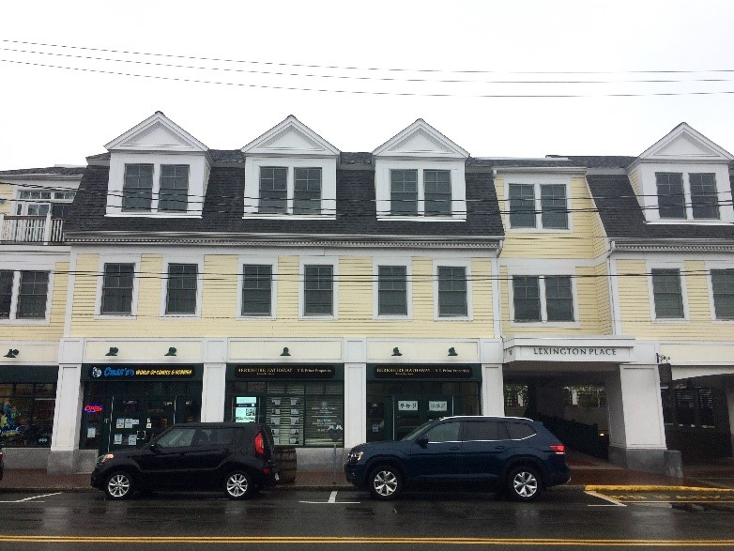
Examples of ~15 Units Per Acre:
Westwood, MA
Norfolk, MA
Sudbury, MA
Source: The Urbanist illustrating new mixed-housing-type subdivision at ~15 units per acre
Lexington, MA
Credit: Amy Dain
Notes:
Voiceover should highlight that there are a variety of housing types to get to 15 units per acre

Slide 16
Importance of Technical Assistance
The Baker-Polito Administration realizes that implementation is going to be complex and challenging, and that some municipalities – possibly many – are going to need help and support of different kinds.
To that end, we are developing a suite of Technical Assistance to support municipalities, over time, with implementation.
EOHED/DHCD/MHP are working to make the process of seeking and receiving technical assistance as streamlined as possible for municipalities.

Slide 17
Technical Assistance (TA) - Continued
From the Massachusetts Housing Partnership (MHP), with consultant support:
Online tools and a clearinghouse of info, available to municipalities at their own pace, to include:
Webinars and training modules, best practices, model ordinances and bylaws, and sample public outreach materials
Grant monies for third-party assistance to municipalities selected based on their readiness to participate and need for support, to include help with:
Drafting/amending bylaws and ordinances, conducting build-out analysis, drawing/mapping district boundaries, etc.
Information and links to all available technical assistance resources for MBTA communities to be posted on the Housing Toolbox
Additional TA opportunities and avenues will include:
FY23 Community One Stop: MBTA Communities can apply for assistance through programs like the Housing Choice Grant Program, Community Planning Grants, and the Rural and Small Town Development Fund
FY23 EOEEA Land Use Planning Grant program will prioritize MBTA municipalities
Support from eight Regional Planning Agencies through prioritization of Commonwealth-provided District Local Technical Assistance (DLTA) funding to municipalities seeking to implement the new provisions and needing help to do so.
And potentially more…

Slide 18
How to Comply in 2022
Each MBTA community will be deemed to achieve interim compliance—and remain eligible for the 2022 One Stop—as long as it completes the “MBTA Community Information Form”.
This online form includes some straightforward requests:
Provide basic information about existing zoning via online form
Discuss the MBTA draft guidance at a meeting of the select board, city council or Town Council
12 communities need to update GIS parcel data needed to make unit capacity and density calculation
To be eligible for MassWorks & Housing Choice Community Grants via the 2022 One Stop Process, you must complete this form by May 2nd, 2022.

Slide 19
Timeline to Finalize Guidelines
Robust Stakeholder Engagement Process (December 15 – March 31):
The Baker-Polito Administration will spend the next few months soliciting input and feedback from key stakeholders, particularly towns and cities.
This process is also designed to educate and inform relevant parties of the expectations, as set forth in the legislation and by the draft guidelines.
Public comment period will end on March 31, 2022.
Final Guidelines to be issued after Stakeholder Engagement Process:
Once final guidelines are developed, communities will be expected to take affirmative steps towards the creation of a compliant multi-family district.
Deadline for having a compliant zoning district as proposed in the draft will be phased-in:
2023 for subway and bus communities
2024 for commuter rail and MBTA adjacent communities

Slide 20
MBTA Communities Timeline, as outlined in Draft Guidelines
December 15, 2021
Draft Guidelines Released & Website Launched
March 31, 2022
Public Comment Period Ends
December 31, 2022
Submit an Action Plan or Request for Compliance Determination
December 31, 2023
Subway and Bus Communities must adopt zoning amendment
May 2, 2022
Deadline to Submit MBTA Community Information Form
March/July 2023¹
Action Plan Approval from DHCD
December 31, 2024
Commuter Rail and Adjacent Communities must adopt zoning amendment
The draft guidelines incorporate timing considerations for MBTA Communities through a phased-in approach.
The intent is to allow communities time to determine the location of the district, the rules within the district, and other important aspects related to overall compliance.
1. As outlined in the draft guidelines, subway communities and bus service communities must obtain DHCD approval of an action plan by no later than March 31, 2023. Commuter rail communities and adjacent communities must obtain DHCD approval of a timeline and action plan by no later than July 1, 2023.

Slide 21
Guidelines and Supplemental Information
Please visit mass.gov/mbtacommunities for:
Draft Guidelines
How to Comply in 2022
Due by 5/2/22
Public Comment(s)
Access to Technical Assistance
Frequently Asked Questions (FAQ)—NEW!
Other important information

