Slide 1
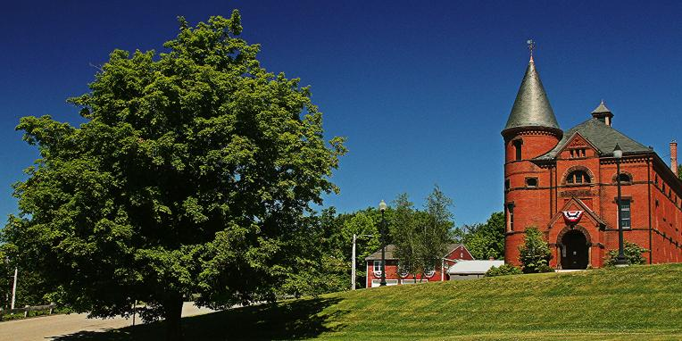
Princeton PFAS update – SPRING 2022
Private Well Monitoring and Phase II Project
Jeffrey Arps, LSP

Slide 2
PFAS Sampling & results
Project Overview
PFAS detected in Town Hall Supply Well – September 2019
Reported to MassDEP November 4, 2019, RTN 2-21072 assigned
MassDEP drinking water standard based on sum of six PFAS compounds (PFAS6). These six compounds are:
Perfluorodecanoic acid (PFDA)
Perfluorononanoic acid (PFNA)
Perfluorooctansulfonic acid (PFOS)
Perfluorooctanoic acid (PFOA)
Perfluoroheptanoic acid (PFHpA)
Perfluorohexanesulfonic acid (PFHxS)
Eight other analytes are reported but are not currently regulated. Six of these eight have not been detected in any Princeton well samples and all detected compounds are removed by the POET systems

Slide 3
Immediate response action (ira)
Potable well impacts constitute IRA, “immediate” action needed
Semi-annual sampling of private wells with PFAS6 detections
Bottled water to properties where PFAS6 are <20 ppt
Town meeting approved POETs for residences where PFAS6 <20
POETs for properties where PFAS6 >20 ppt
Semi-annual IRA Status Reports and semi-annual monitoring reports
POET sampling:
Sample effluent within first month
After 1 year, sample mid-fluent and effluent semi-annually
After 2 years, sample mid-fluent and effluent quarterly until GAC changed
16 homes will move to quarterly sampling in April 2022 (underway)
IRA modifications are evaluated based on data

Slide 4
PFAS Sampling & results (WELLS)
Project Updates
Additional sampling between October 2021 and April 2022
One new home had a detection: 20 Worcester Street (reported at 1.8 ppt, the Reporting Limit)
30 POET systems installed (PFAS6 >20 ppt), one pending
47 properties provided with bottled water (PFAS6 <20 ppt) residences have the option to add a POET
26 homes around the edges of all radii are ND for PFAS
No “breakthrough” has been detected at any POET (i.e., no detection of PFAS in water after treatment in primary GAC vessel)
April sampling round currently underway, results will be reported in June Status Report

Slide 5
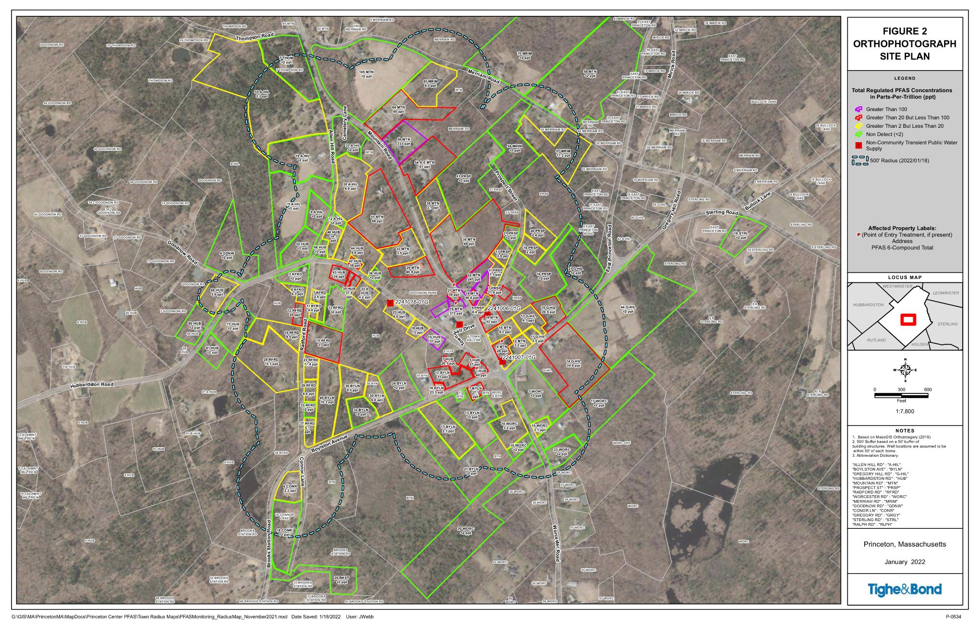
January 2022 Radius Map

Slide 6
Massachusetts Contingency Plan (MCP)
The MCP Process Consists of five “phases,” Phases I through V
Phase I – (submitted November 9, 2020). Initial Site Assessment and Tier Classification (site is Tier I due to drinking water impacts)
Phase II – due November 2023. Define vertical and horizontal extent of PFAS in all media (soil, groundwater, surface water, air), risk characterization.
Phase III – due November 2024. Evaluation of remedial alternatives
Phase IV - due with Phase III. Plan to implement remedy selected in Phase III
Phase IV Completion/Phase V – due November 2025. Document remedy completion
Sites can be closed at any time during this process with permanent or temporary solution
IRA runs parallel to the “phase” process – no deadlines / IRA Status Reports

Slide 7
Phase ii comprehensive site assessment
Current and on-going Phase II investigation efforts include:
Quarterly groundwater monitoring at Town Hall campus
Groundwater samples collected January 25, 2022
Seven monitoring wells sampled (four bedrock, three overburden)
PFAS6 ranges from 4.4 to 540 ppt
MW-102 (highest concentrations) not sampled – snow
Three wells (two bedrock, one overburden) <GW-1 standard
Decreases in one bedrock well (240 ppt to 176 ppt) and one overburden well (490 ppt to 248 ppt)
Minor increases in other two bedrock wells (45 ppt to 53 ppt, and 506 ppt to 540 ppt)

Slide 8
Other matters (continued)
Single-vessel POETs approved by Town vote in November 2021
For homes that have PFAS6 <20 ppt, to discontinue bottled water
Bid package prepared and sent out April 19
Bids will be due by May 12
Expect summer installations
Anyone with PFAS6 <20 ppt interested in a POET needs to confirm with Sherry Patch by May 8 so vendors know how many are needed
Stockpile of Catch Basin Materials at DPW
Sampling to evaluate for presence of PFAS
Runoff Sampling
Runoff near 30 Mountain Road and 41 Prospect Street sampled in April
Data pending

Slide 9
Project plan
April 2022 – Semi-annual private well/POET sampling
30 Mountain Road – finalize plan for treatment of water runoff
Dye test storm drain system along Mountain Road and Gregory Hill Road to confirm flow and discharge locations for stormwater runoff in the center of the affected area
Continuing to evaluate shallow soil data to determine whether additional soil sampling or remediation is warranted
Conduct sampling of stockpile of catch basin materials
Next status report due in June 2022

