Slide 1
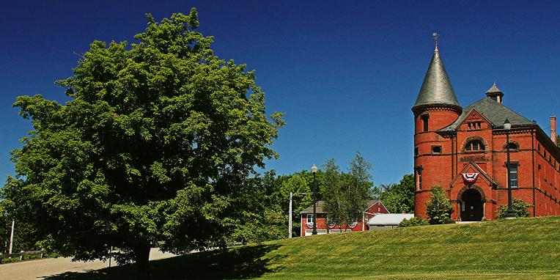
Princeton PFAS update – FALL 2022
Jeffrey Arps, LSP

Slide 2
PFAS Sampling & results
Project Overview
  PFAS detected in Town Hall Supply Well – September 2019
  Reported to MassDEP November 4, 2019, RTN 2-21072 assigned
  MassDEP drinking water standard based on sum of six PFAS compounds (PFAS6). These six compounds are:
  Perfluorodecanoic acid (PFDA)
  Perfluorononanoic acid (PFNA)
  Perfluorooctansulfonic acid (PFOS)
  Perfluorooctanoic acid (PFOA)
  Perfluoroheptanoic acid (PFHpA)
  Perfluorohexanesulfonic acid (PFHxS)
  Eight other analytes are reported but are not currently regulated. Six of these eight have not been detected in any Princeton well samples and all detected compounds are removed by the POET systems

Slide 3
Immediate response action (ira)
  Potable well impacts constitute IRA, “immediate” action needed
  Semi-annual sampling of private wells with PFAS6 detections
  POETs for properties where PFAS6 >20 ppt
  Bottled water to properties where PFAS6 are <20 ppt
    Town meeting approved POETs for residences where PFAS6 <20
    Residents notified by letter of POET option
    Contract awarded on September 14, 2022
    Contractor has begun pre-installation site visits
    Installations to begin in October
  Semi-annual IRA Status Reports (March and September)
  Semi-annual monitoring reports (June and December) discontinued
  POET sampling (PFAS6 >20 ppt):
      Sample effluent within first month
      After 1 year, sample mid-fluent and effluent semi-annually
      After 2 years, sample mid-fluent and effluent quarterly until GAC changed
        22 homes will move to quarterly sampling in October 2022 (underway)
  IRA modifications are evaluated for submittal to DEP based on data

Slide 4
PFAS Sampling & results (private WELLS)
Project Updates
    Last sampling round completed in April 2022
    One new home had a detection: 25 Worcester Road (reported at 4.1 ppt), 41 Worcester Road added to monitoring program
    October sampling round scheduled, results will be reported in March Status Report
    31 POET systems installed (PFAS6 >20 ppt), one pending
      One breakthrough detected in April 2022 (secondary vessel moved to primary; new GAC installed in secondary vessel)
    28 homes around the edges of all radii are ND for PFAS

Slide 5
PFAS Sampling & results
Project Updates (continued)
    Town Hall POET system complete and operating as of April 2022
    40 locations provided with bottled water (PFAS6 <20 ppt), residences have the option to add a POET

Slide 6
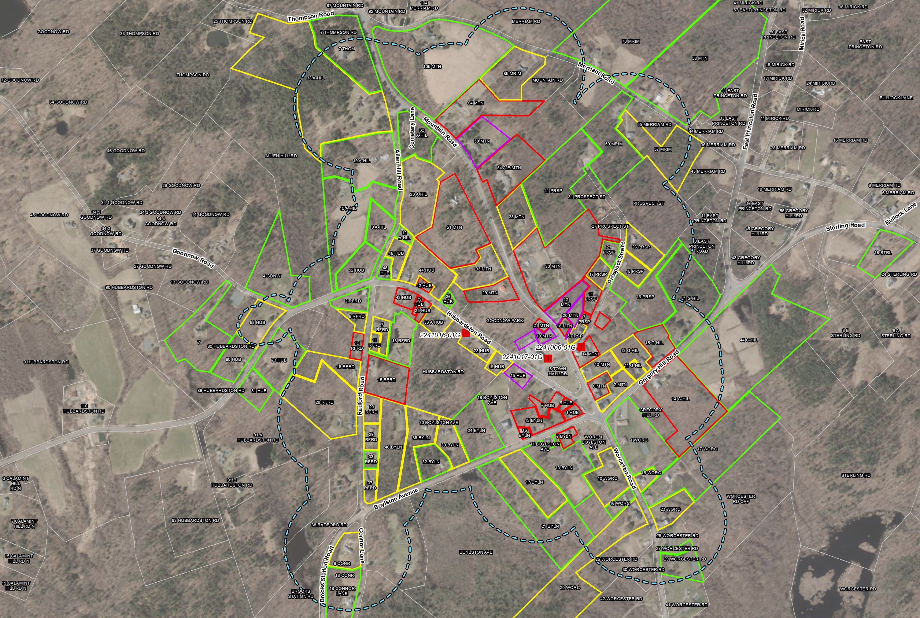
august 2022 Radius Map

Slide 7
Massachusetts Contingency Plan (MCP)
The MCP Process Consists of five “phases,” Phases I through V
  Phase I – (submitted November 9, 2020). Initial Site Assessment and Tier Classification (site is Tier I due to drinking water impacts)
  Phase II – due November 2023. Define vertical and horizontal extent of PFAS in all media (soil, groundwater, surface water), risk characterization.
  Phase III – due November 2024. Evaluation of remedial alternatives
  Phase IV - due with Phase III. Plan to implement remedy selected in Phase III
  Phase IV Completion/Phase V – due November 2025. Document remedy completion
  Sites can be closed at any time during this process with permanent or temporary solution
  IRA runs parallel to the “phase” process – no deadlines / IRA Status Reports

Slide 8
Phase ii comprehensive site assessment
  Current and on-going Phase II investigation efforts include:
  Semi-annual groundwater monitoring at Town Hall campus
    Seven groundwater samples collected in January 2022
      MW-102 could not be sampled due to snow
      Two groundwater samples collected in May 2022
      MW-101 (290 ppt) and MW-102 (930 ppt)
      Results lower than Jan 2022 (MW-101) and Sept 2021 (MW-102)
    Groundwater samples collected from 8 monitoring wells on October 5, 2022
      Data pending

Slide 9
Phase ii CSA (continued)
  USEPA to collect soil samples at 30 Mountain Road
  Requested by MassDEP
  USEPA visited the property on Aug 15 and Oct 11
  Planning to sample soil next month, with focus around foundation
  Drainpipe Inspection – 30 Mountain Road
  In-pipe camera used to view pipe interior on Sept 26
  Pipe runs straight from sump in basement to discharge point
  Clay pipe in good condition - 15-foot section of perforated pipe
  Planning a future site visit during a rain event to confirm source(s) of water prior to installing the proposed treatment system

Slide 10
Phase ii CSA (continued)
  Runoff Sampling
  Runoff sampling at 30 Mountain Road: September 2022 results higher than April 2022 but lower than results prior to April 2022
  Runoff sampling at 41 Prospect Street discontinued after three quarterly rounds without detections (PFAS never detected)

Slide 11
Project plan
  October 2022 – Semi-annual private well/POET sampling
  Contractor to install single-vessel POETs this fall
  30 Mountain Road – continue to evaluate drainage infrastructure and sources of runoff, and review USEPA soil sampling data
  Next semi-annual status report due in March 2023
  Next PFAS public information session April 2023

