Slide 1
Hiking with GPS
Navigating Trails, Exploring, and finding your way out of the woods
Planning hikes and seeing distances and elevations
Knowing where you are heading, what is nearby, and where you have gone
Rick Gardner - April 2020

Slide 2
Agenda
SESSION 1
Introduction: GPS Apps and View Ranger
Tracking your hikes: Tracks
SESSION 2
Planning Hikes: Routes
Other Features and Settings, including GPX Files

Slide 3
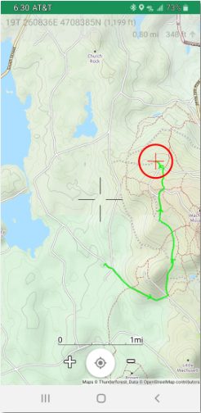
GPS Apps
Many Free Apps for Planning and Tracking Hikes
View Ranger, Gaia, AllTrails, others
Hike with a selection of Maps
See trails, roads, mountains, lakes, satellite view
Save tracks for later use
See statistics such as miles, elevation, time
Capture photos
Plan routes and analyze difficulty
Other Features!!

Slide 4
View Ranger is my choice! Others work similarly

Slide 5
Part 1
Taking a walk and tracking with View Ranger
A Few Definitions
GPS: Global Positioning Satellite
Track: A recording of the GPS Points in a walk
Route: A PLAN for a hike, prepared ahead of time

Slide 6
Installing View Ranger
Getting Started
Install View Ranger
Free for basic; $5/Year for Premium;
$20/Year for Premium with added maps
Create ID and Password. This will also be used by the ViewRanger Web Site.
Follow the prompts to complete the install

Slide 7
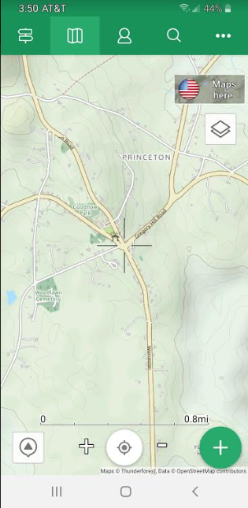
5
View Ranger Panel
4
Center the view around current location
Start a new Track, Route, or Capture a Point of Interest (POI)
Layers: Choose Maps or save maps for offline use
Get a list of all routes or tracks to select
More: Settings, Synchronize, etc
Sky View – See what is on the horizon
3
6
1
2

Slide 8
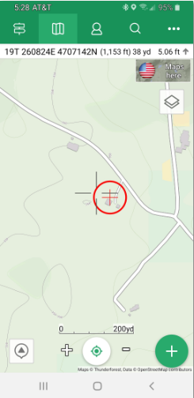
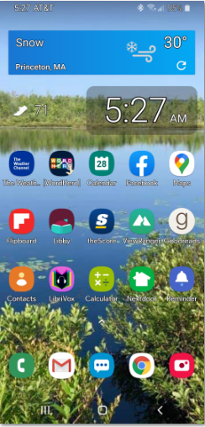
Starting out…
Click View Ranger App
Screen Opens to show the default Map
Select Layers Icon and choose Map – Open Cycle Map
Click Center icon to center the map around YOU
Note: Expand of Compress Map by using +/- buttons
3
1
4

Slide 9
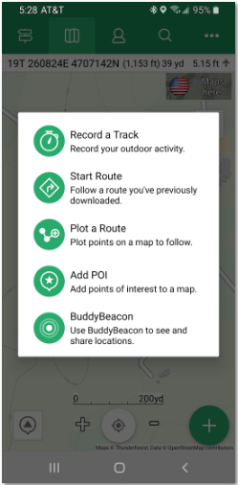
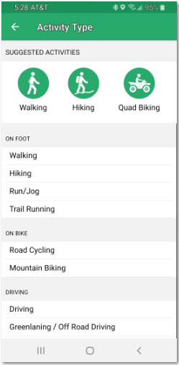
Starting out…
Click the large green + button to start a track
Select “Record a Track”
Select Activity Type
View Ranger will then start tracking your GPS points
Use defaults on GPS Settings to start…but these can be varied.
3
2
1

Slide 10
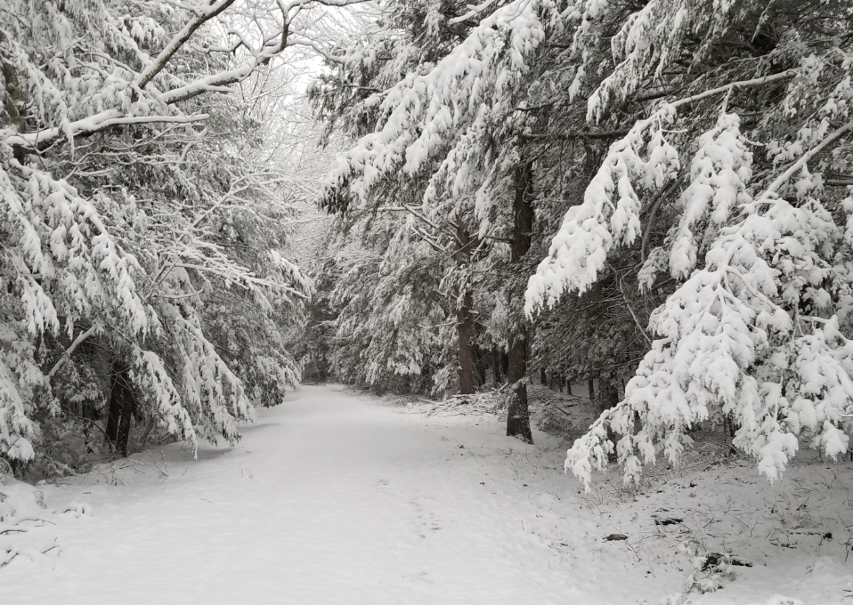
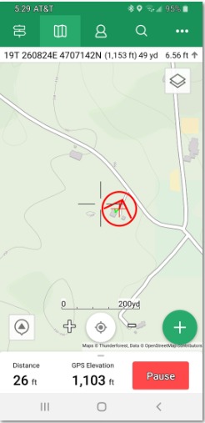
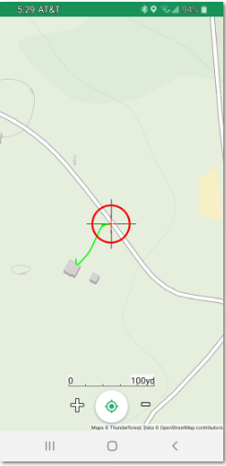
Beginning a track…
View Ranger will start drawing a green line as you walk
Distance is tracked at the bottom, but you can hide this panel to see more map
You can always pause the tracking if you want to stop or go off-trail

Slide 11
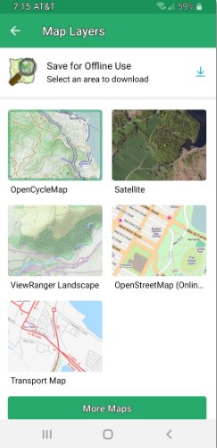
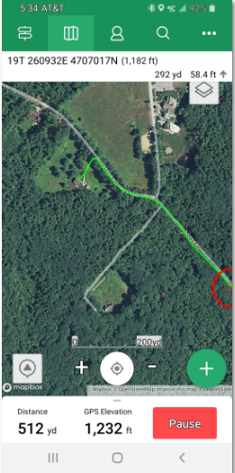
Switching Maps
Open Cycle Map is the best for TRAILS. But you may want a Street view map or satellite view.
You can switch by using the Layers icon.
Satellite view is great if you are bushwacking or if you are wondering when you will get to an open field for lunch!!
You can get added maps (but questionable value!)

Slide 12
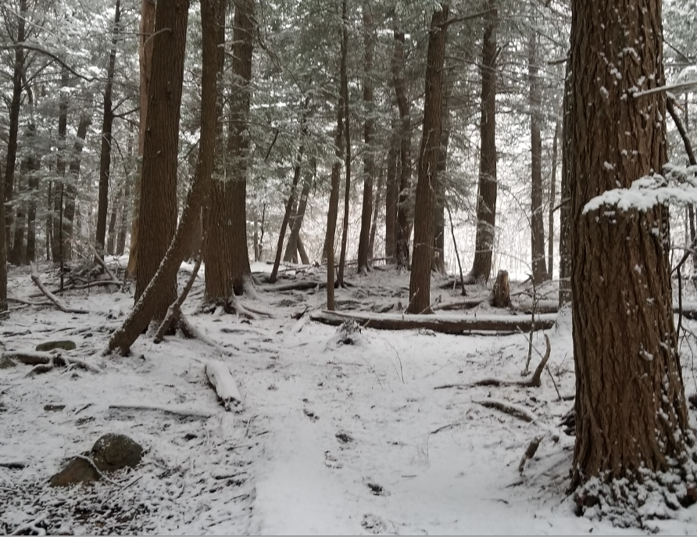
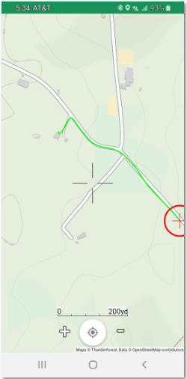
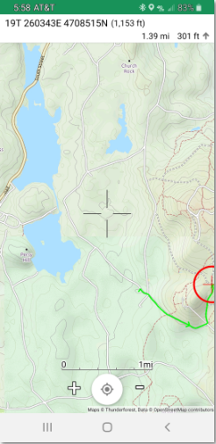
How far to….?
3b
Tracking proceeds as you walk…in this case up to Admin Road and then into WMSR
Can hit the center button to re-center
BUT…if I want to know how far it is to another point on the map…
Move the center cross-hairs to the target position
The distance shows at the top
So…1.39 miles
3a

Slide 13
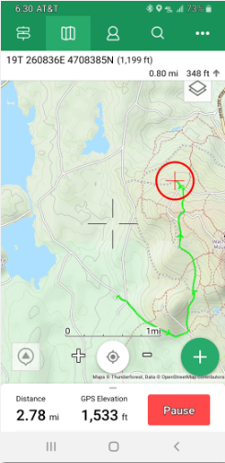
Stopping at North Road Lookout
Walked Admin Road to Semuhenna to North Road
Stopped at North Road Lookout
Can see all trails around me
Can Zoom into the map
Can see distance and elevation

Slide 14
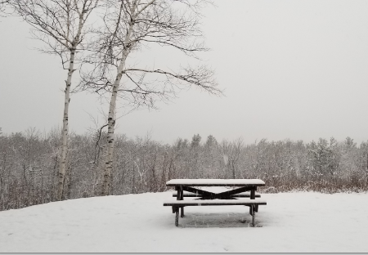
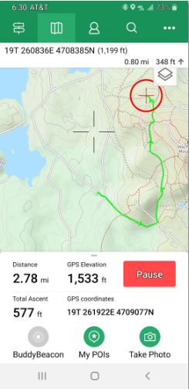
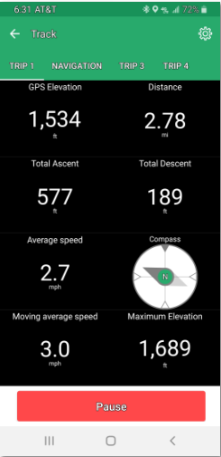
Stopping at North Road Lookout
Can drag up the bottom panel to see more
Flag a Point of Interest or take a photo to store with route
Touch the distance or Elevation and see the larger panel on the right
Back button to get back to the map

Slide 15
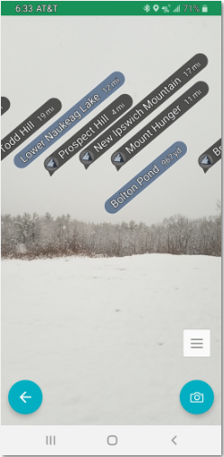
Stopping at North Road Lookout
If you buy the $5.00 per year ‘Premium’ edition you can use the skyline feature
Click the skyline icon
On the right, see the landscape features and distances.
2

Slide 16
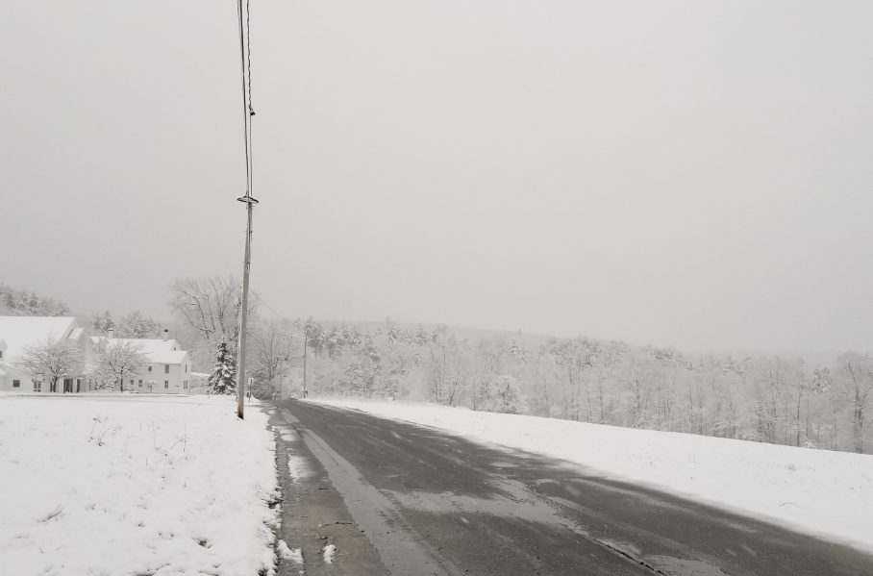
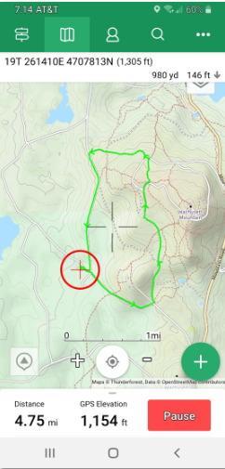
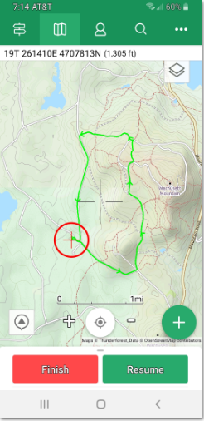
Completing the Track
Click Pause
A pop-up will ask you to confirm
Click Finish
Add a good description of the hike

Slide 17
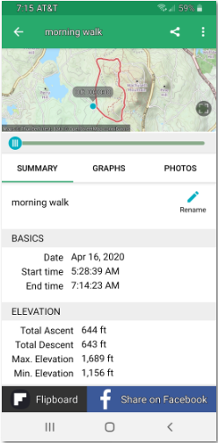
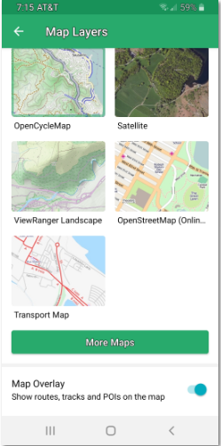
Completing the Track
From the closing panel, you can see times, distance, elevation, walking rate, and other statistics
Also see graphical representations
Saved version also goes to the ‘cloud’ for viewing on your desktop
If you set you Map Overlay ON, your track will always show on your main screen
4

Slide 18
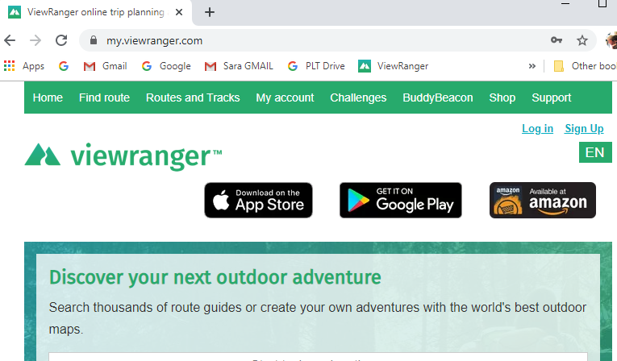
The View Ranger Web App
MyViewRanger.com
Enter ID and Password from your phone setup
Mostly use the ‘Routes and Tracks’ Option
Lots of video tutorials available
Can also search the web for specific help. Type ViewRanger in Google Queries!
3
4

Slide 19
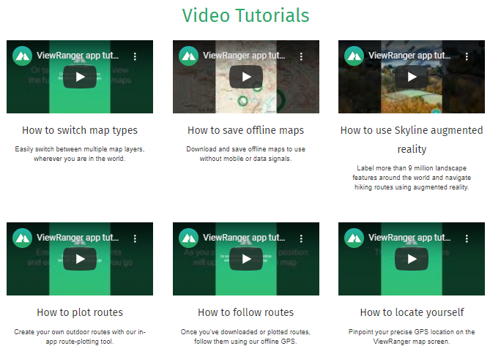
Some Tutorials

Slide 20
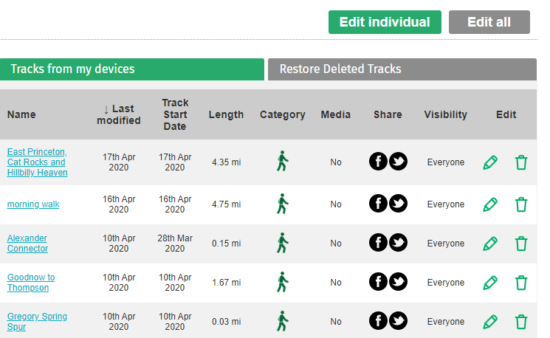
Working with your Tracks
View the Tracks and statistics
Change the names
Export to GPX for sharing
Make a track public
Delete a track
The web app also can be used to create Routes.
Subject of the next class, will present soon!!

Slide 21
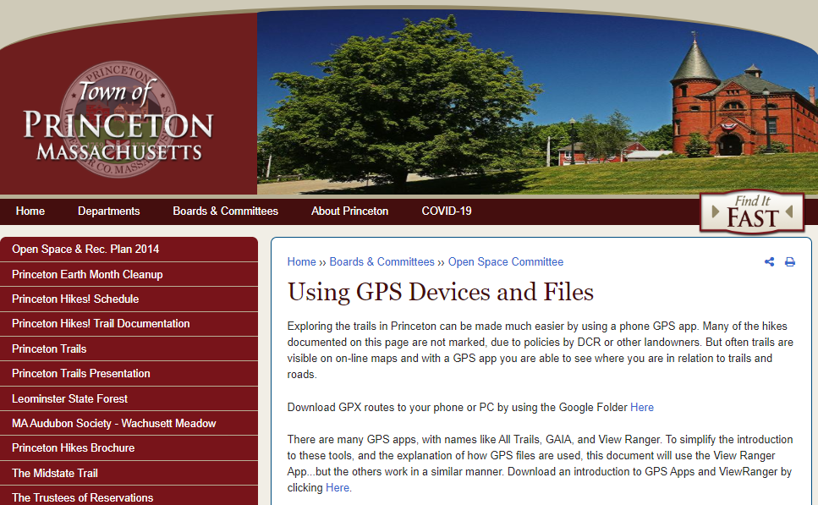
Download this Presentation – Open Space Page
Click Trail Documentation, then link for GPS Apps

Slide 22
Closing Notes
Try it out…go for a hike!! Check it frequently while you hike, and kick the tires!
To minimize battery use, you can turn on airplane mode. Useful for long hikes!
Also try out myviewranger.com. We will be using that more in the second session

Slide 23
Session 2 will be Next Week
(Tuesday at 4 or Thursday at 7)
Planning Routes
Synchronizing between Phone and Web
Following Routes
Creating Routes from Tracks
Exchanging GPX Routes
Tracking Co-Hikers - Buddy Beacon
Settings

Slide 25
Hiking with GPS – Session 2
SESSION 1
Introduction: GPS Apps and View Ranger
Tracking your hikes: Tracks
SESSION 2
Planning Hikes: Routes
Other Features and Settings, including GPX Files

Slide 26
Session 2 will be Next Week
(Tuesday at 4 or Thursday at 7)
Planning Routes
Synchronizing between Phone and Web
Following Routes
Creating Routes from Tracks
Exchanging GPX Routes
Tracking Co-Hikers - Buddy Beacon
Settings

Slide 27
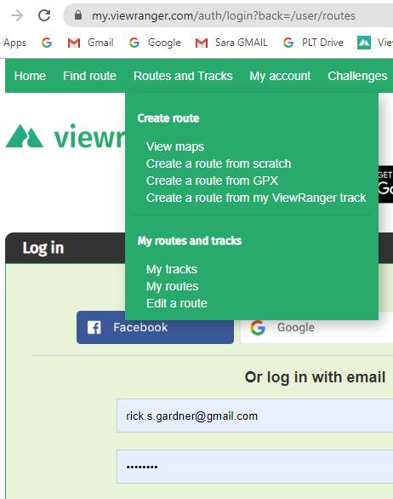
Recording a Route – Getting Started
Routes can be planned from the phone or the web interface
BUT…use the web to see the maps best!
You can also create Routes from GPX files or from Tracks

Slide 28
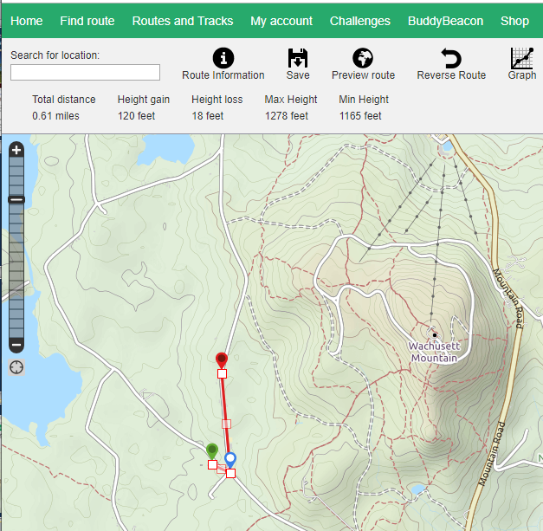
Recording a Route – Plotting the Route
Click to start, and then continue to click around the trail that you are following
Click and drag to move a point
Right click on a point to delete or to set a ‘waypoint’
Waypoints can be named and given a special icon

Slide 29
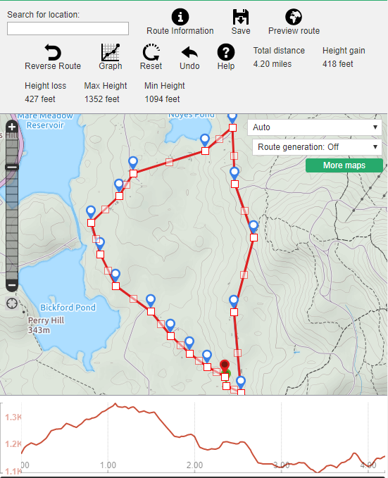
Recording a Route – Statistics
6
4
Finish the route.
I often expand the map at this point and fine tune the route.
The top of the screen shows some statistics …distance and elevation
Click ‘Graph’ Button to see the altitude profile on the bottom
Drag the cursor across the graph to see where the points are on the map
You can also reverse the route.
5

Slide 30
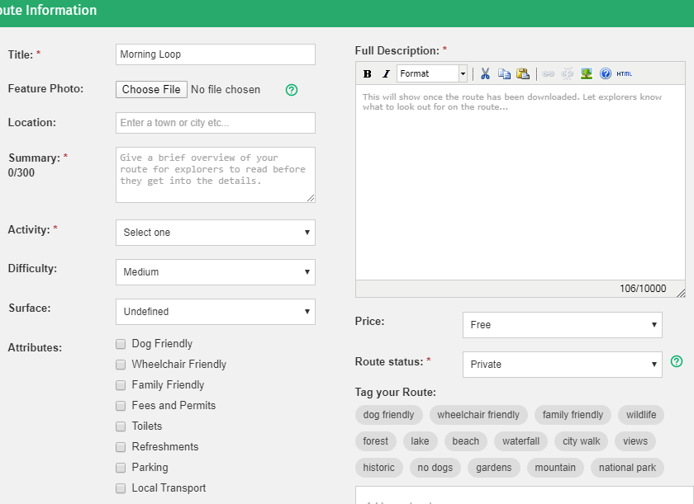
Recording a Route – Naming and Documenting
Click ‘Route Information’
Assign a name
Add further description as desired

Slide 31
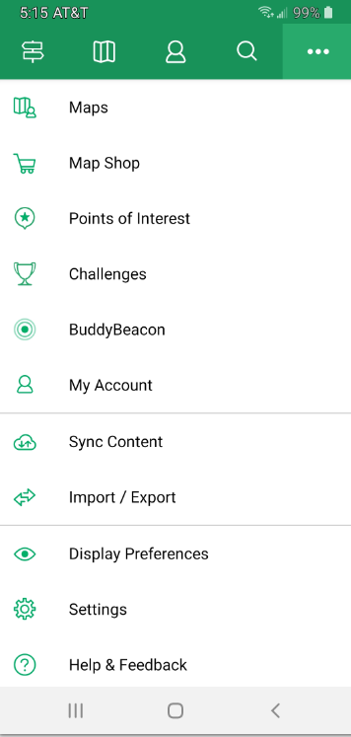
1
Synchronizing the Route
Click the three dots on the top right
Click ‘Sync Content to pull the route down to your phone
All objects will be synchronized
2

Slide 32
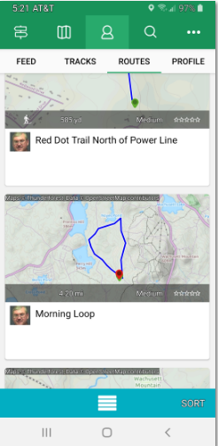
Following a Route
Click the plus button’
Select ‘Start Route’
Select the route that you want to follow
Display will switch to the map and show the route, and will start tracking
2
1

Slide 33
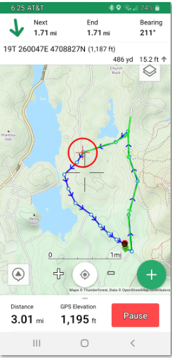
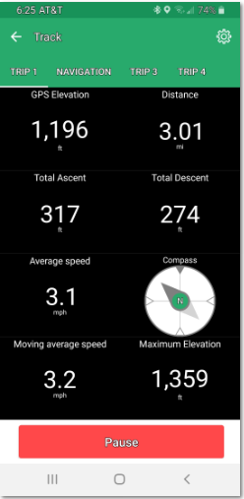
Following a Route - Statistics
Now you are tracking vs the Route
Route in blue
Track in green
Can check statistics
Display shows distance to next way point or to end
A chart is also available to show upcoming altitude for the next mile
Regular statistics capabilities are available
Finish track normally

Slide 34
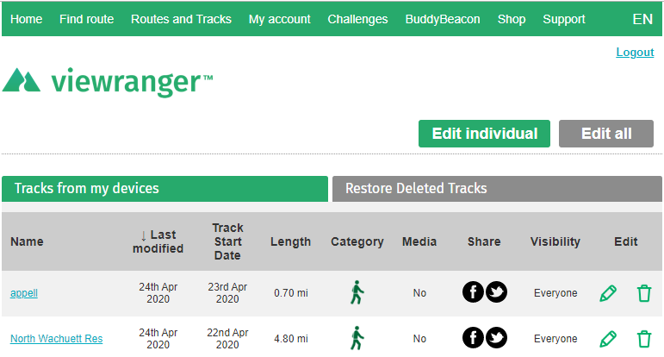
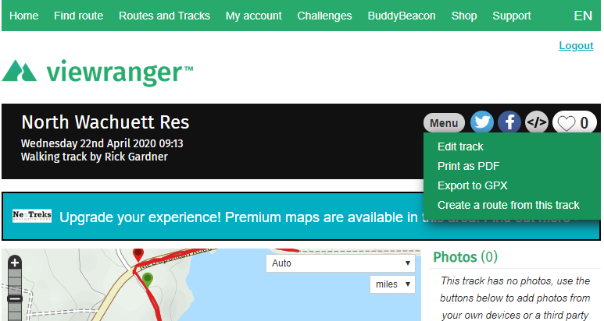
Creating Routes from Tracks
On the web, click Routes and Tracks
Select ‘My Tracks’ or ‘My Routes’
Click on the hyperlink to open the Track or Route
Click Menu
Click ‘Export to GPX’
3
4
5

Slide 35
Exchanging GPX Tracks
GPX File is simply a listing of coordinates, time, and altitude
You can find and eMail GPX tracks
Import either route or track GPX files into ViewRanger
You can then edit the route as desired
This is also the way to Copy Routes
Synchronize to get the route to your phone

Slide 36
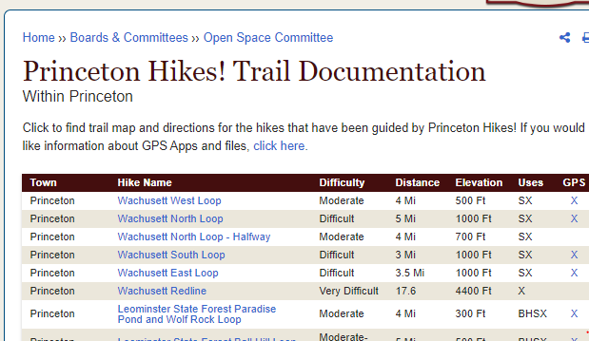
Get GPX Tracks from the Princeton Hikes! Web Page
A work in process.
I will be adding more

Slide 37
Buddy Beacon – Keeping Track of Co-Hikers
Buddy Beacon provides a way to keep track of a co-hiker that might be going faster or slower
Requires a little bit of setup on both View Rangers
Shows as a dot on the map
3

Slide 38
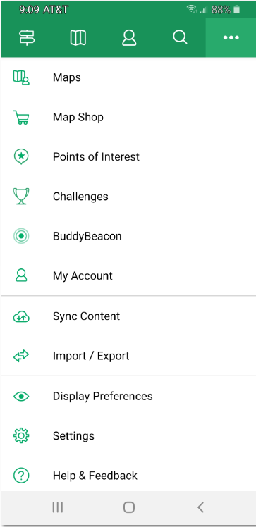
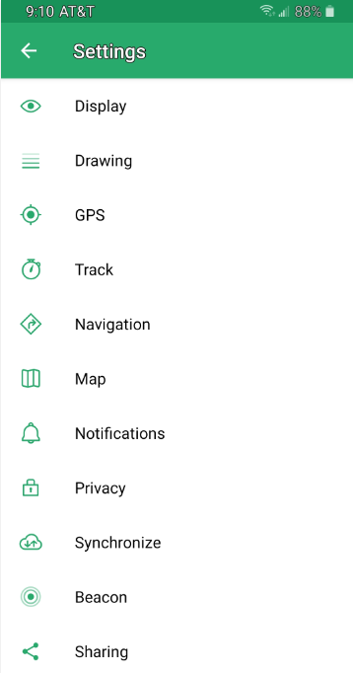
Settings
Settings provide a way to customize how ViewRanger works
Examples:
Display Settings
Customize colors used to draw lines
Set notifications
Set timings for tracks and GPS
Configure the information panels
Set buddy beacon frequency
But….use these sparingly at first!!
1

Slide 39
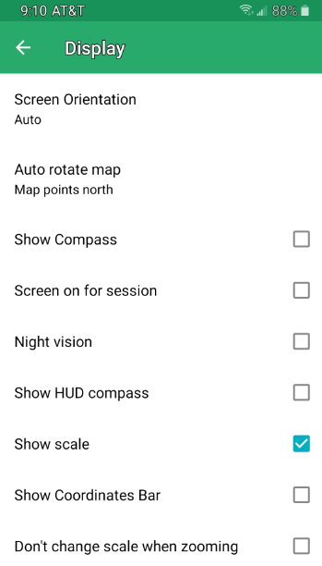
Settings - Display
1
Display Settings
I like to have my map ALWAYS point north
Night vision is useful when hiking at night (dark background)
2
3

Slide 40
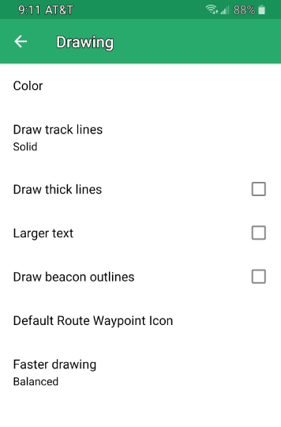
Settings - Drawing
Drawing Settings
Set colors for routes and tracks
Change the types of lines
Etc.
2
1
3

Slide 41
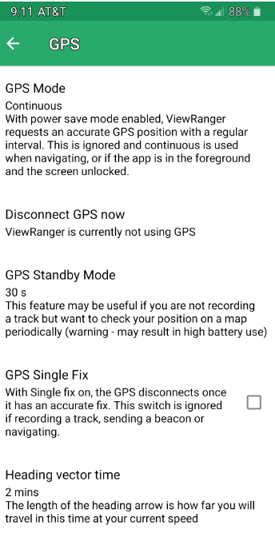
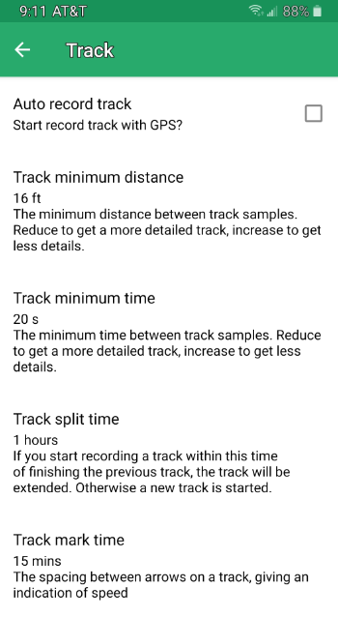
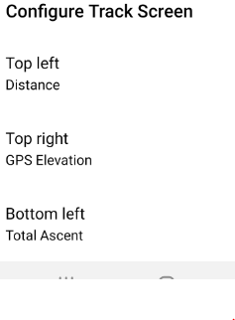
Settings – Track and GPS
GPS and Track Settings
Control how the GPS works, how frequently it polls, etc.
Track allows you to control how tracks terminate
I’ve never changed these but they could be useful!
The bottom of the Track panel allows you to choose statistics for the display

Slide 42
Closing Notes
Try it out…go for a hike!! Check it frequently while you hike, and kick the tires!
To minimize battery use, you can turn on airplane mode. Useful for long hikes!
Some settings, like GPS and Track, will also effect battery life
Take advantage of the GPS tracks on the Princeton Hikes page….
Also try out myviewranger.com. We will be using that more in the second session

