Slide 1
Article 6 Public Safety Building Design Funding
Presented: May 15, 2021

Slide 2
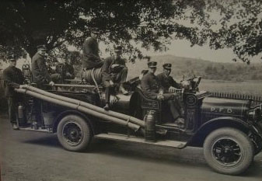
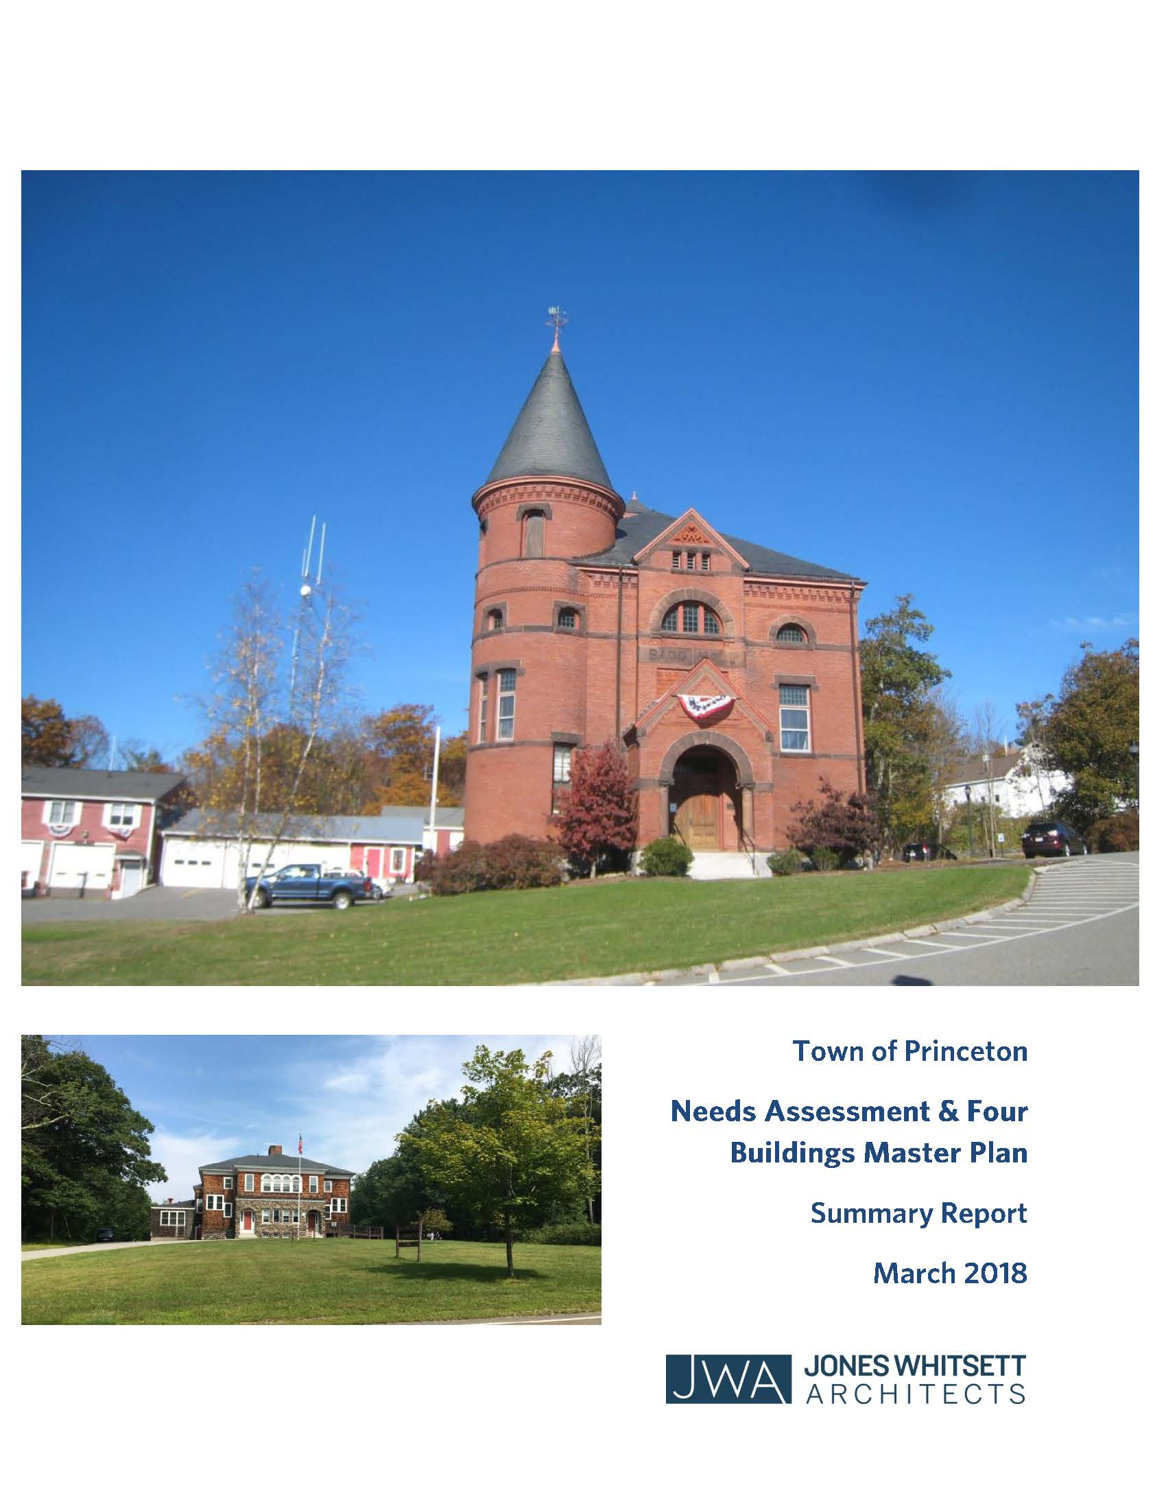
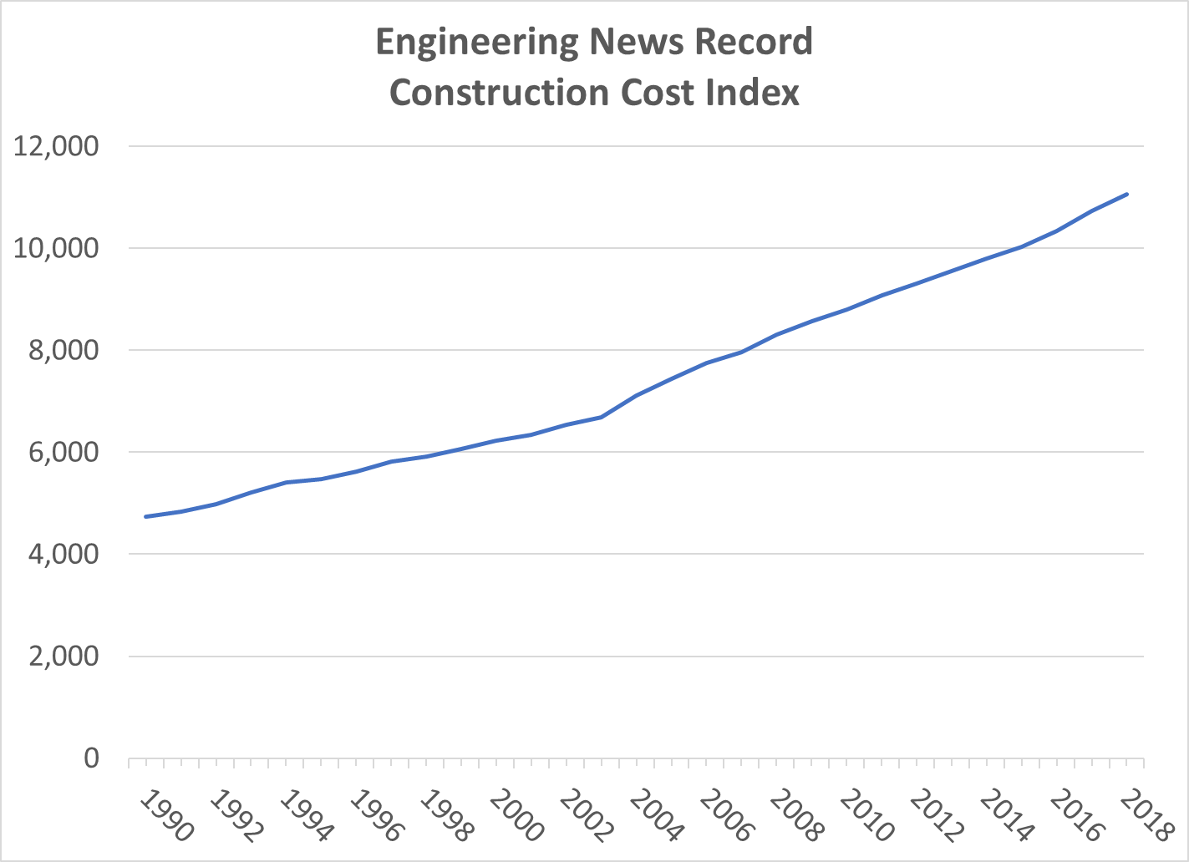
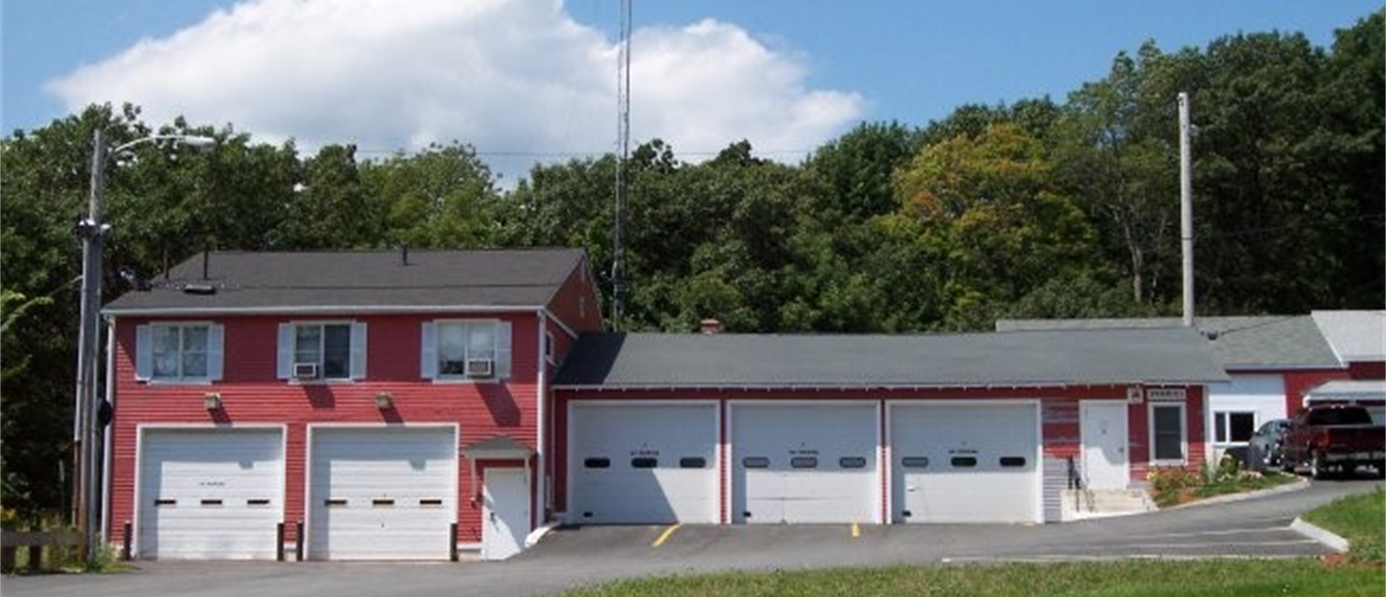
Progress To Date
Prior Professional Studies Document Deficiencies & Needs
Existing Building Not Worth Saving
Best New Site at Princeton Center
Codes & Technical Requirements Have Evolved
Facility Size 15,000 SF to 22,000 SF
Alternate Project Delivery & Funding Options Considered
It Will Not Cost Less To Build In The Future
3.5% + Average Annual Cost Increase

Slide 3
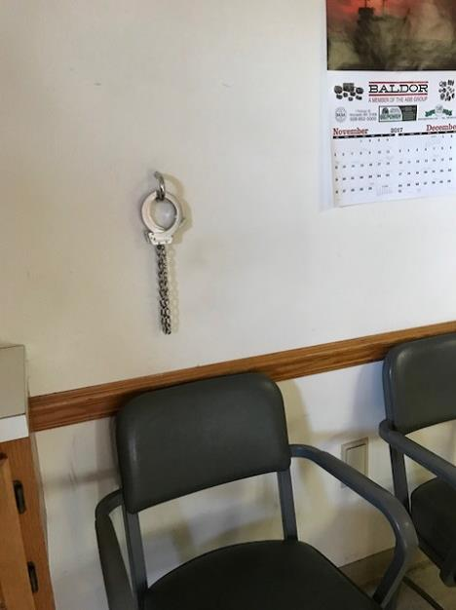
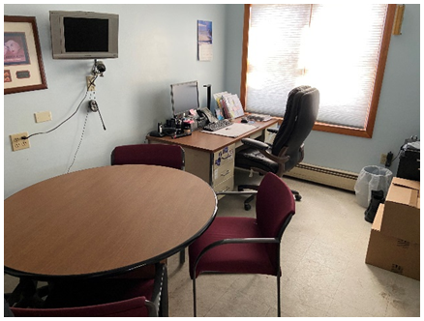
Police Station Deficiencies
Unsafe prisoner loading area
No holding cell endangers prisoners, staff & visitors
No interview space; no privacy for confidential matters
Inadequate evidence and file storage
Inadequate equipment and firearms storage
Inadequate separation of genders (shared bathrooms and locker rooms)
CONCLUSION: Lack of critical spaces for safe operation is a major concern

Slide 4
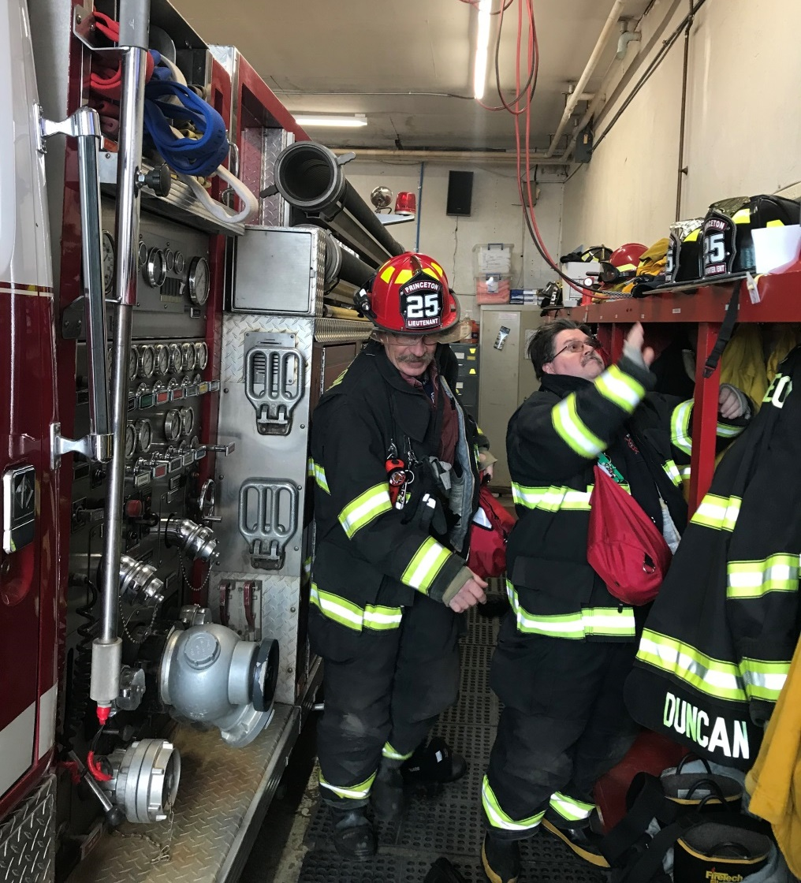
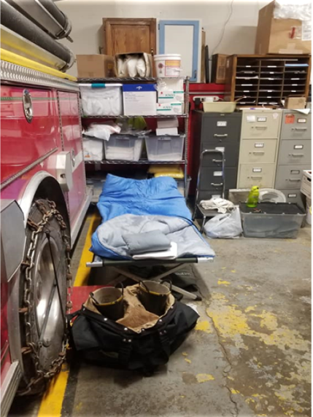
Fire Station Deficiencies
Critical spaces are lacking:
Turnout gear room
Secure narcotics space
Secure storage for HIPAA records
Sleeping quarters for extended emergencies
Locker rooms
Office space
EMS supply space
No exhaust evacuation system
Decontamination space (showers and laundry)
Insufficient parking
CONCLUSION: Lack of critical spaces for safe operation is a major concern

Slide 5
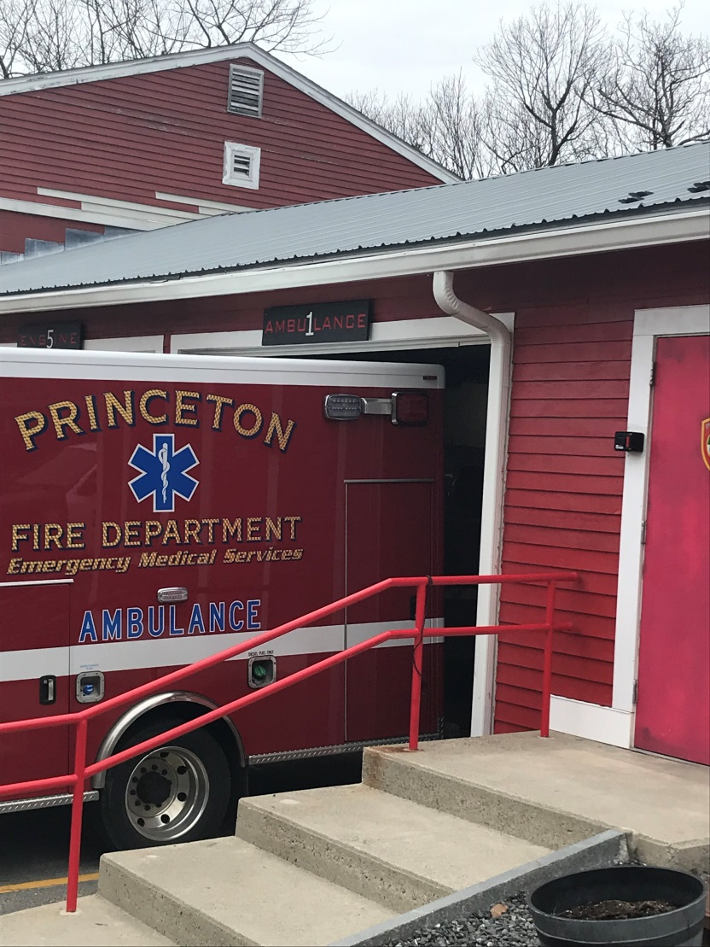
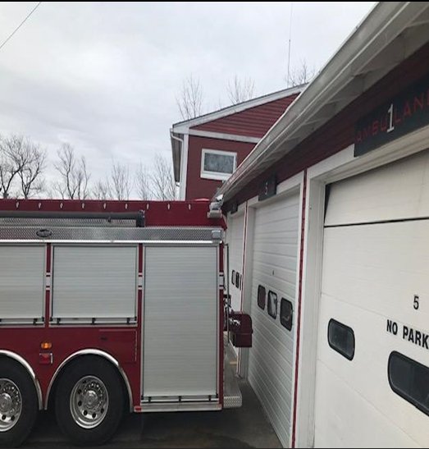
Architectural & Structural Deficiencies
Roof sags over garages due to truss failure
Severe chloride damage in concrete vault space
Water infiltration through foundation and floor
Mechanical, electrical & plumbing systems at end of life
Exterior siding and trim at end of life
Fire equipment barely fits, newer trucks don’t fit
CONCLUSION: Building is not worth saving

Slide 6
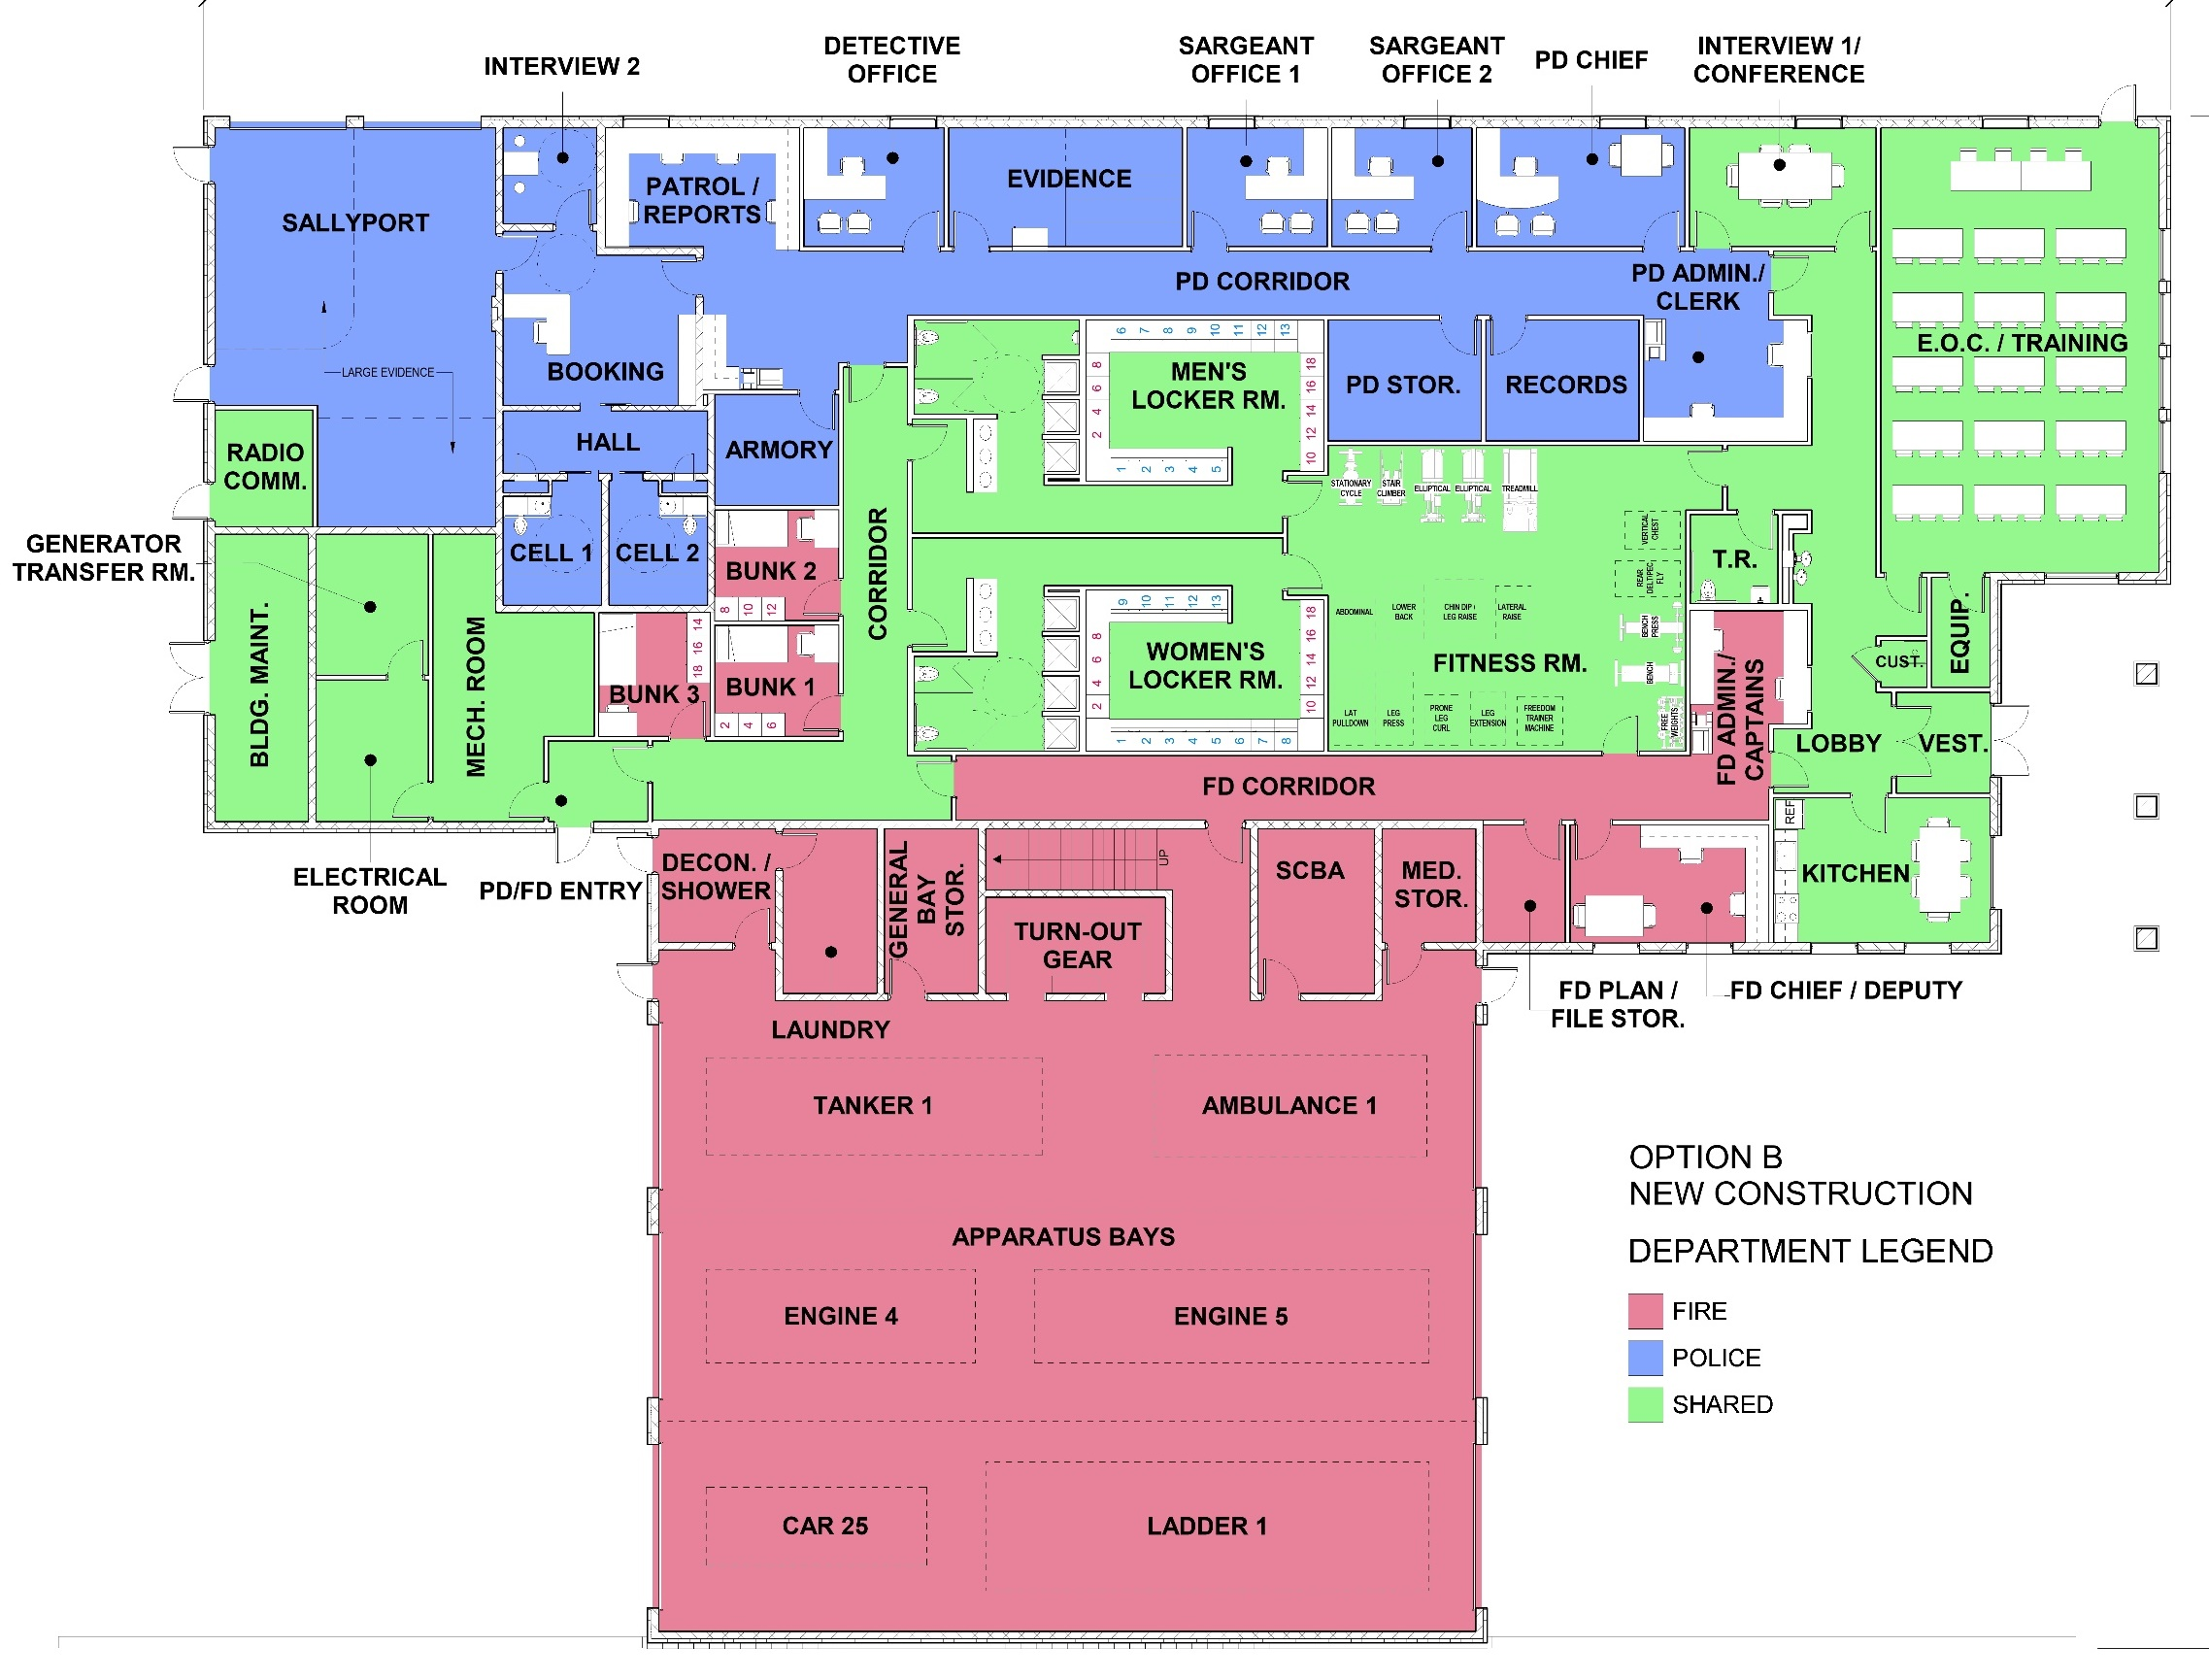
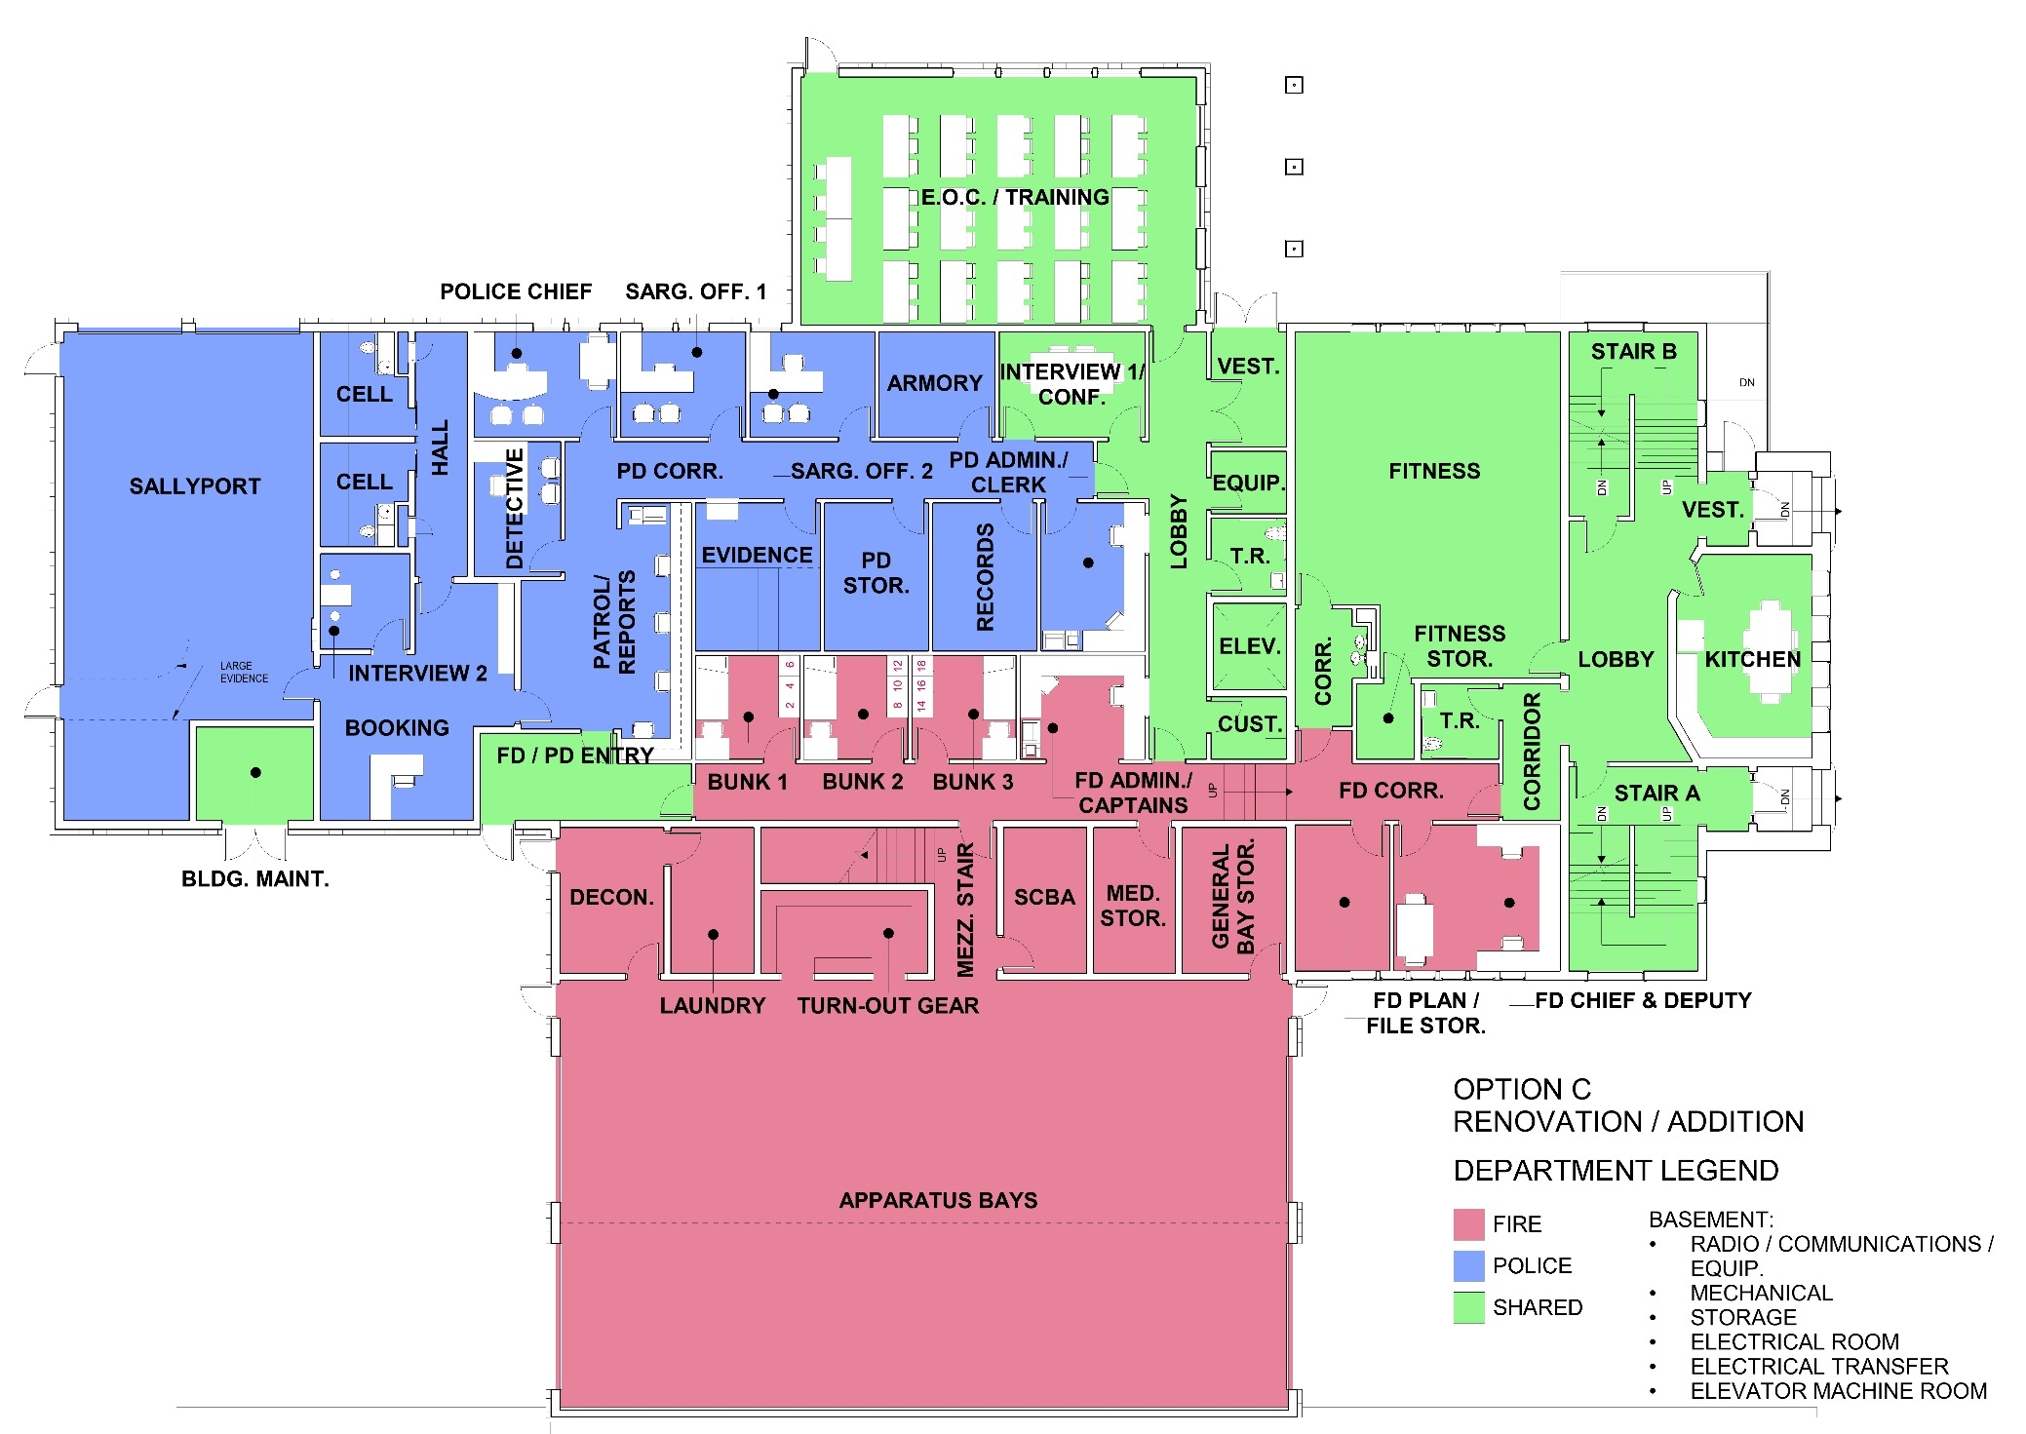
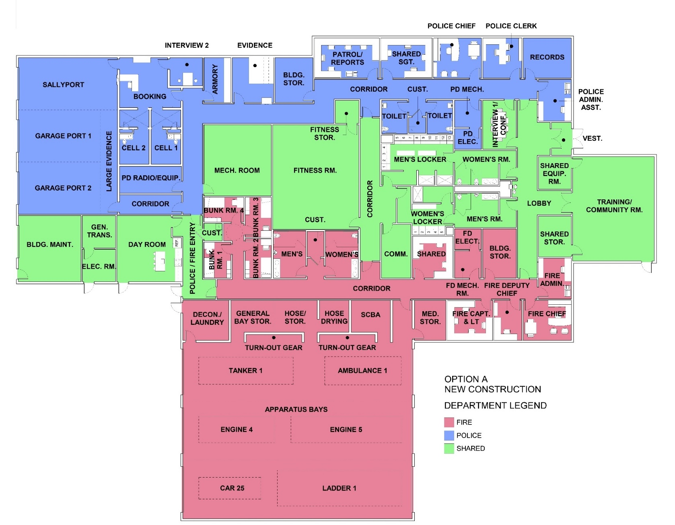
Alternatives & Recommended Plan
OPTION
“C”
Area = 18,476 SF
Construction Cost = $10.6 M
OPTION
“B”
Area = 15,509 SF
Construction Cost = $9.7 M
OPTION
“A”
Area = 19,270 SF
Construction Cost = $10.8 M
Facility to comply with:
MA Police Accreditation Commission
Federal Commission on Accreditation
for Law Enforcement
NFPA complaint design

Slide 7
Next Steps
Initiate Final Design
July 2021
60% Design Delivery & Cost Estimate
Value Engineering Review
October 2021
Complete Construction October 2023
Design Funding $850,000 Approval
2021 ATM
90% Design Delivery & Cost Estimate
January 2022
100% Design Delivery & Advertise Bid
February 2022
ATM
2021
2022
2023
2024
Denotes Resident Feedback Opportunity
Initiate Construction
July 2022
Design Funding Request Summary:
Free Cash $152,000
General Stabilization Account $218,000
Existing PSB Account $480,850
Total: $850,850
Appropriate Construction Funding
May 2022
Open Bids
April 2022

Slide 8
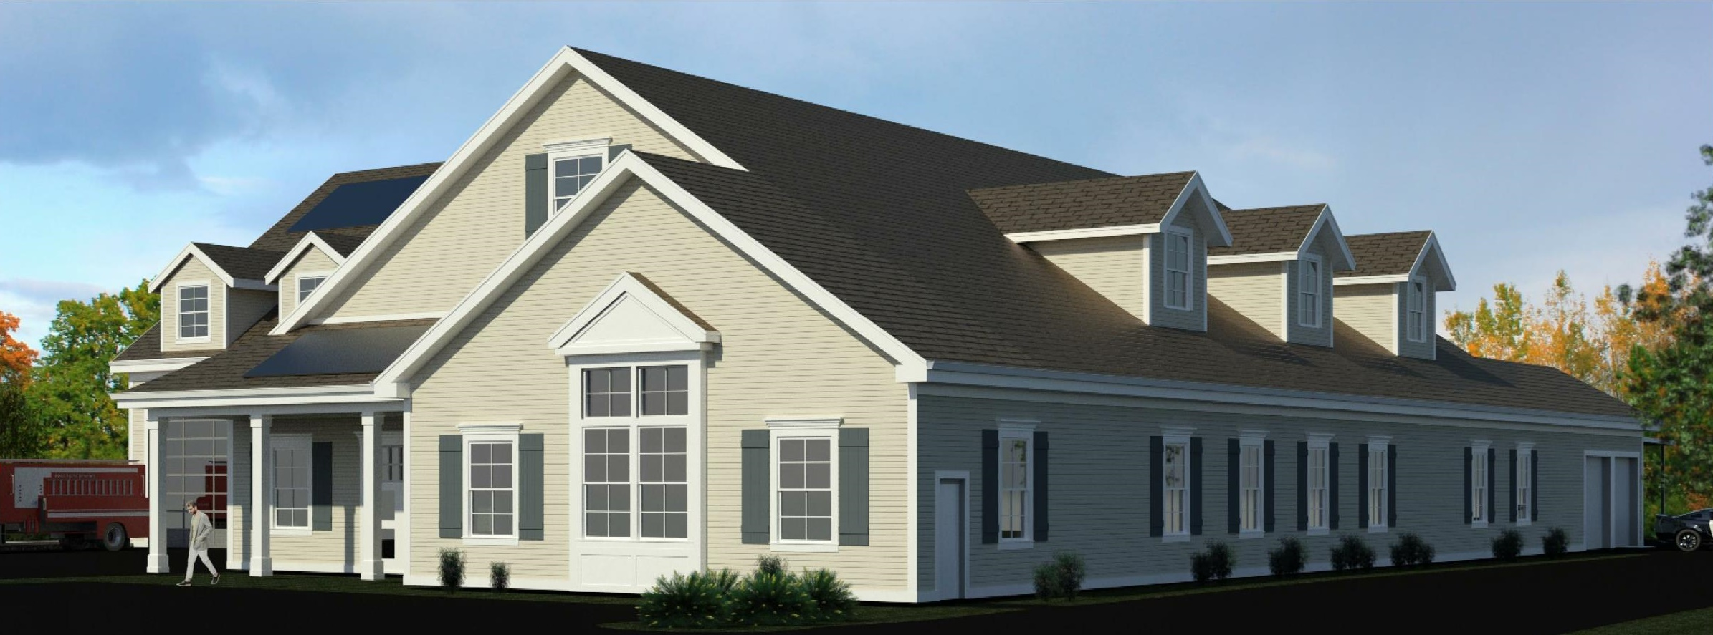
Discussion

Slide 9
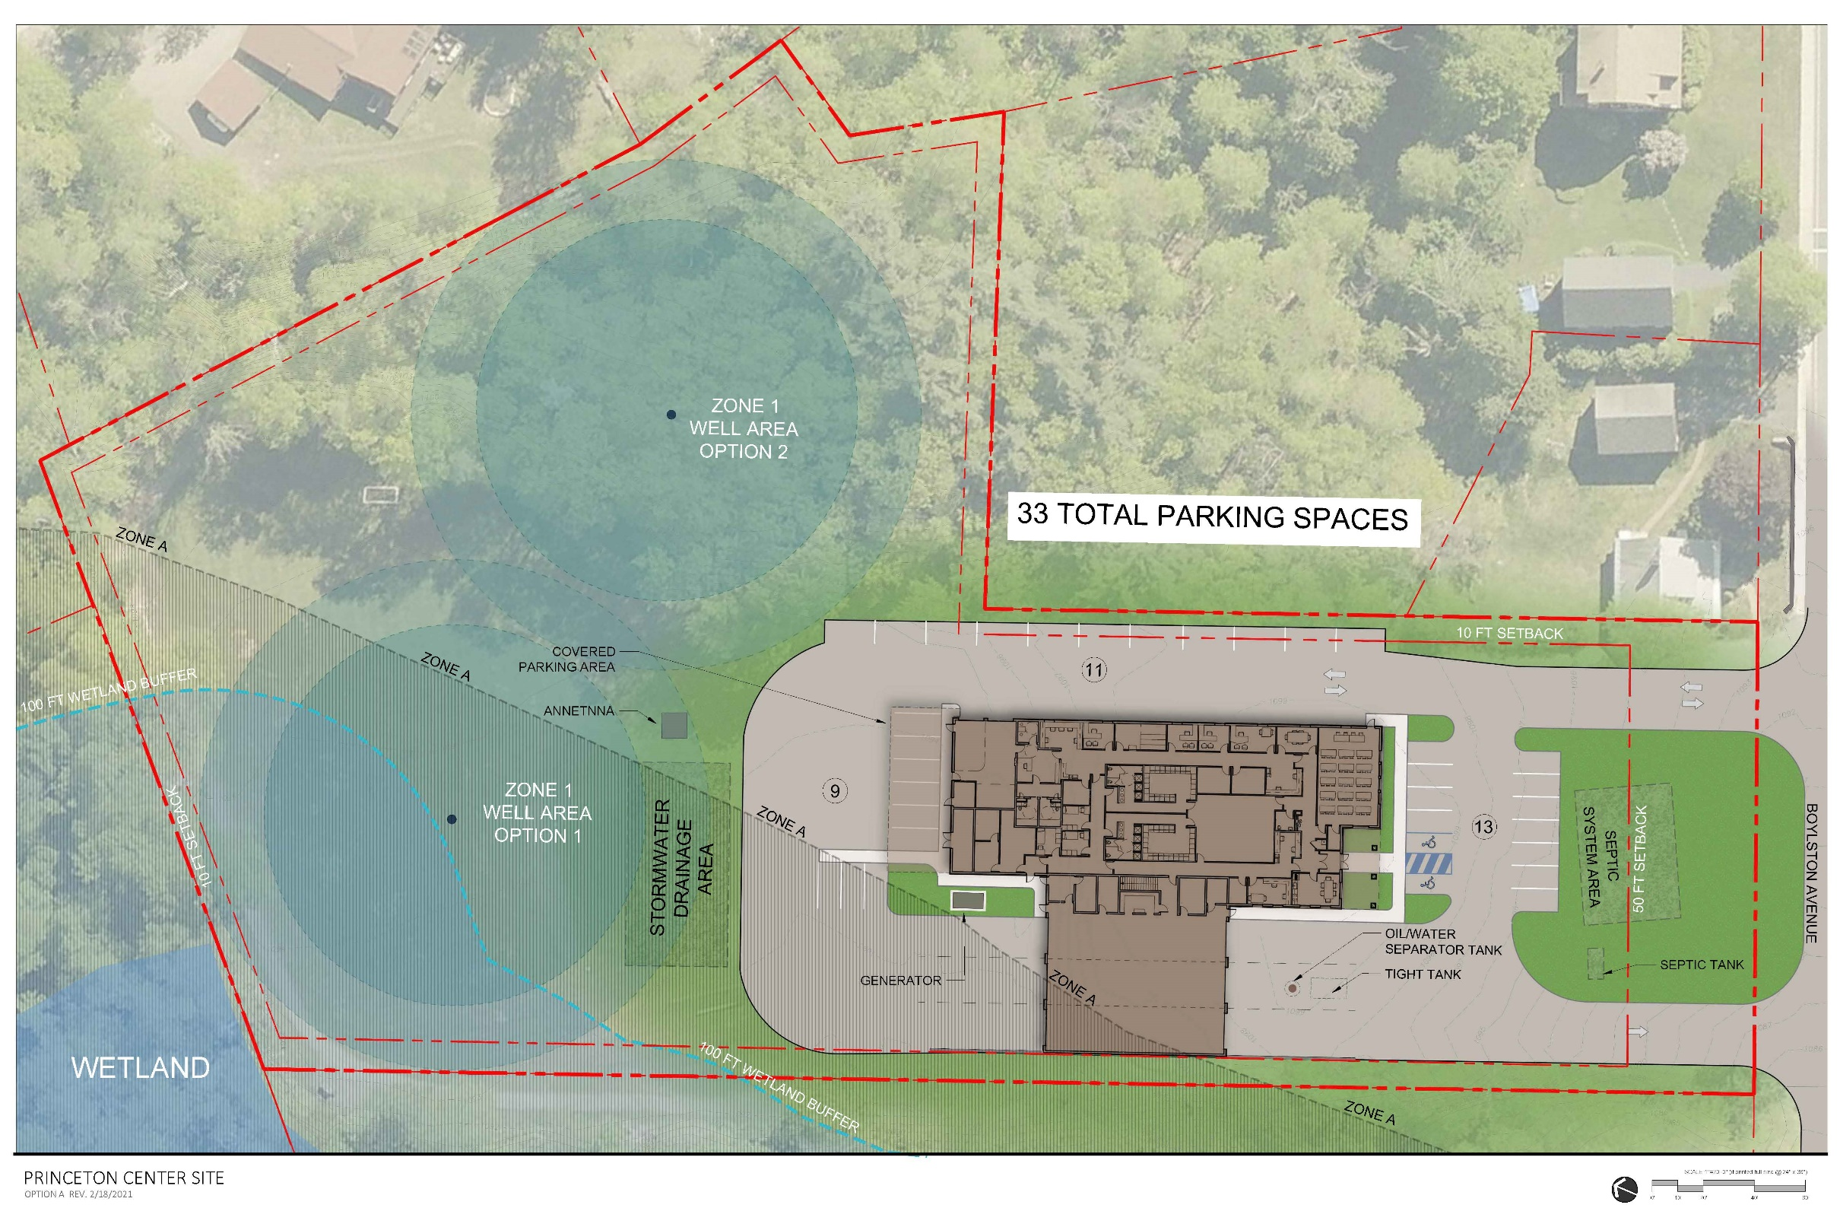
Discussion

